Slide 1

FPT STUDENT INTERNSHIP MANAGEMENT SYSTEM
1

Slide 2
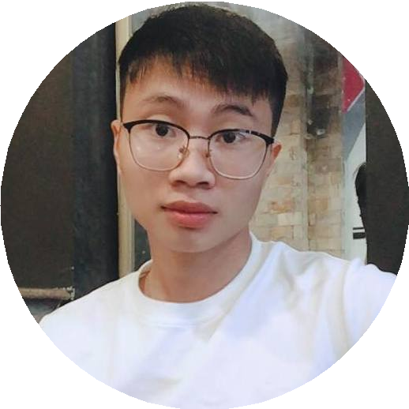
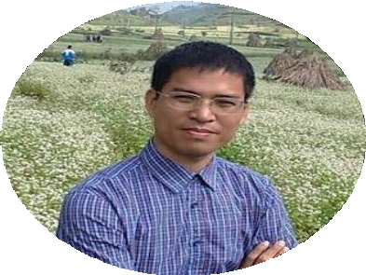
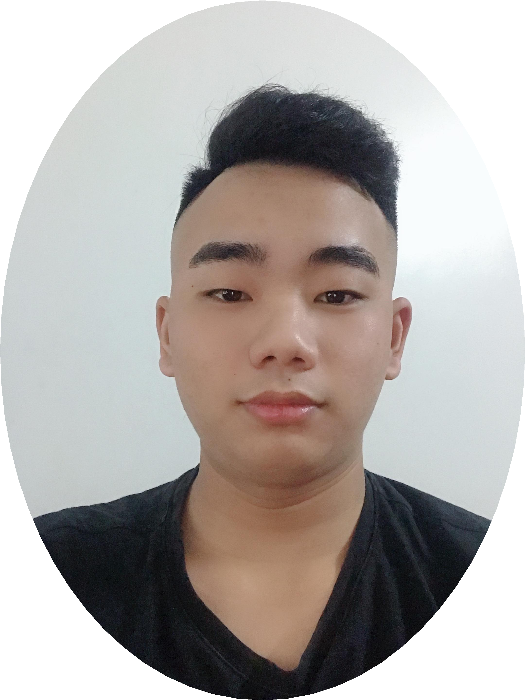

OUR TEAM
2
TEAM LEADER
DEVELOPER , TESTER
Nguyen Huu Hoa
SUPERVISOR
Mr. Nguyen Tat Trung
DEVELOPER, TESTER
DEVELOPER, DESIGN
Bui Cong Tung
DEVELOPER, Q&A
Tran Quang Tho

Slide 3


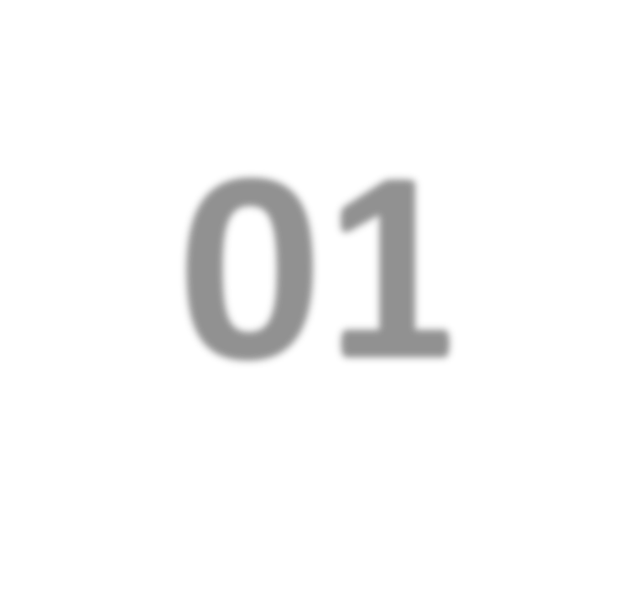


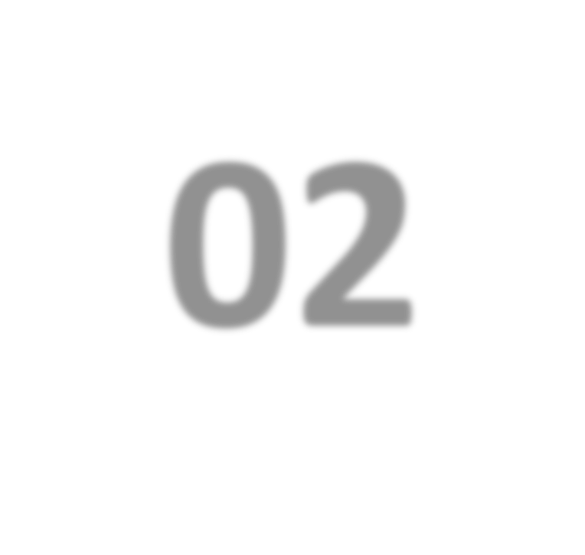
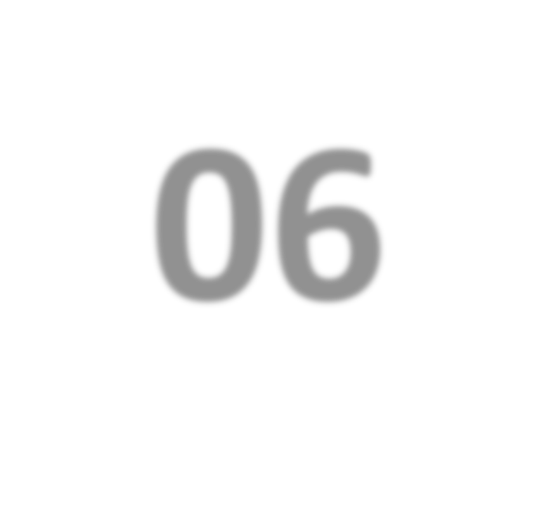


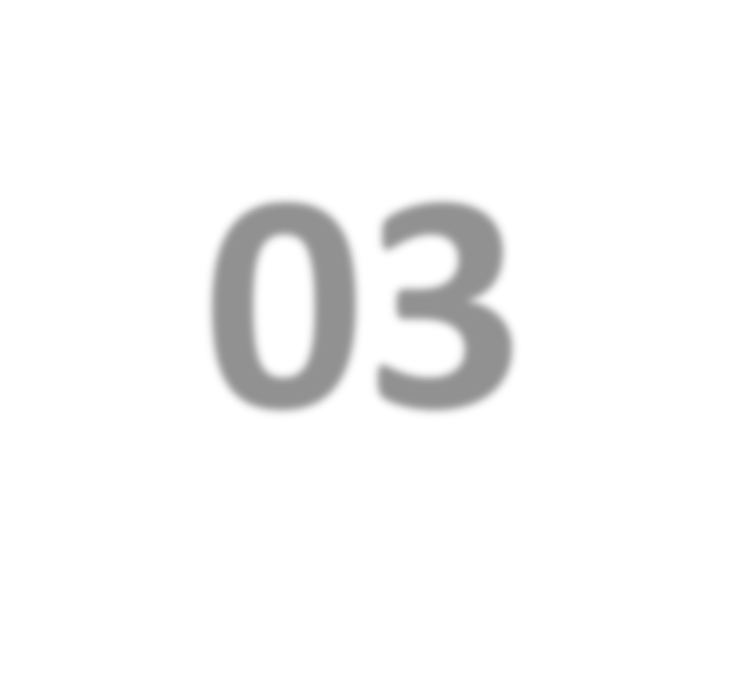
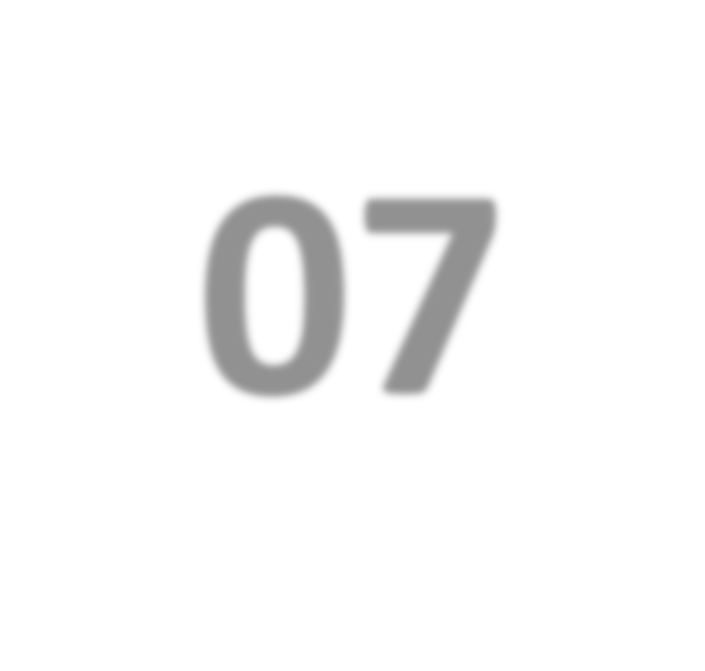


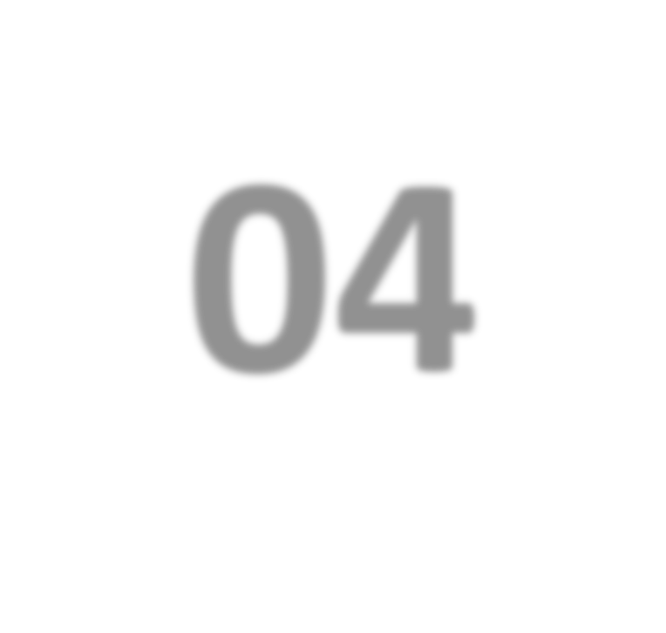
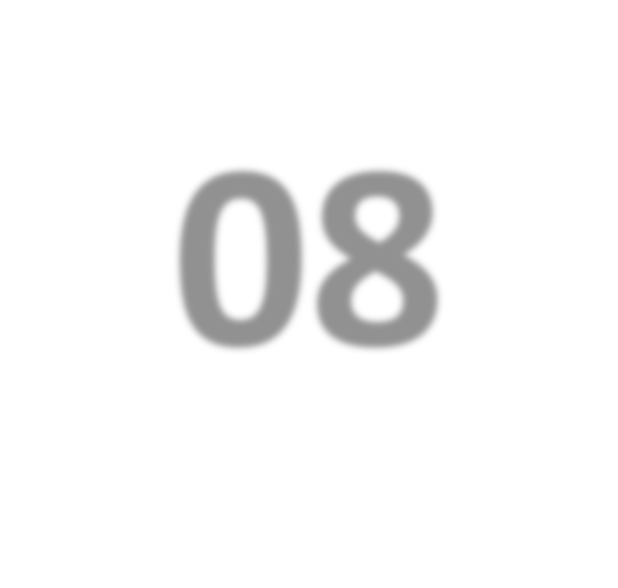
TABLE OF CONTENTS
3
CURRENT SITUATION & SOLUTION
05
DATABASE TABLE DIAGRAM
01
02
PROJECT MANAGEMENT
06
DETAIL DESIGN
03
SOFTWARE REQUIREMENTS SPECIFICATION
07
TEST PLAN ENVIRONMENT TEST
04
ARCHITECTURE DESIGN
08
DEMO, Q&A

Slide 4
01
4
Current Situation & Solution

Slide 5
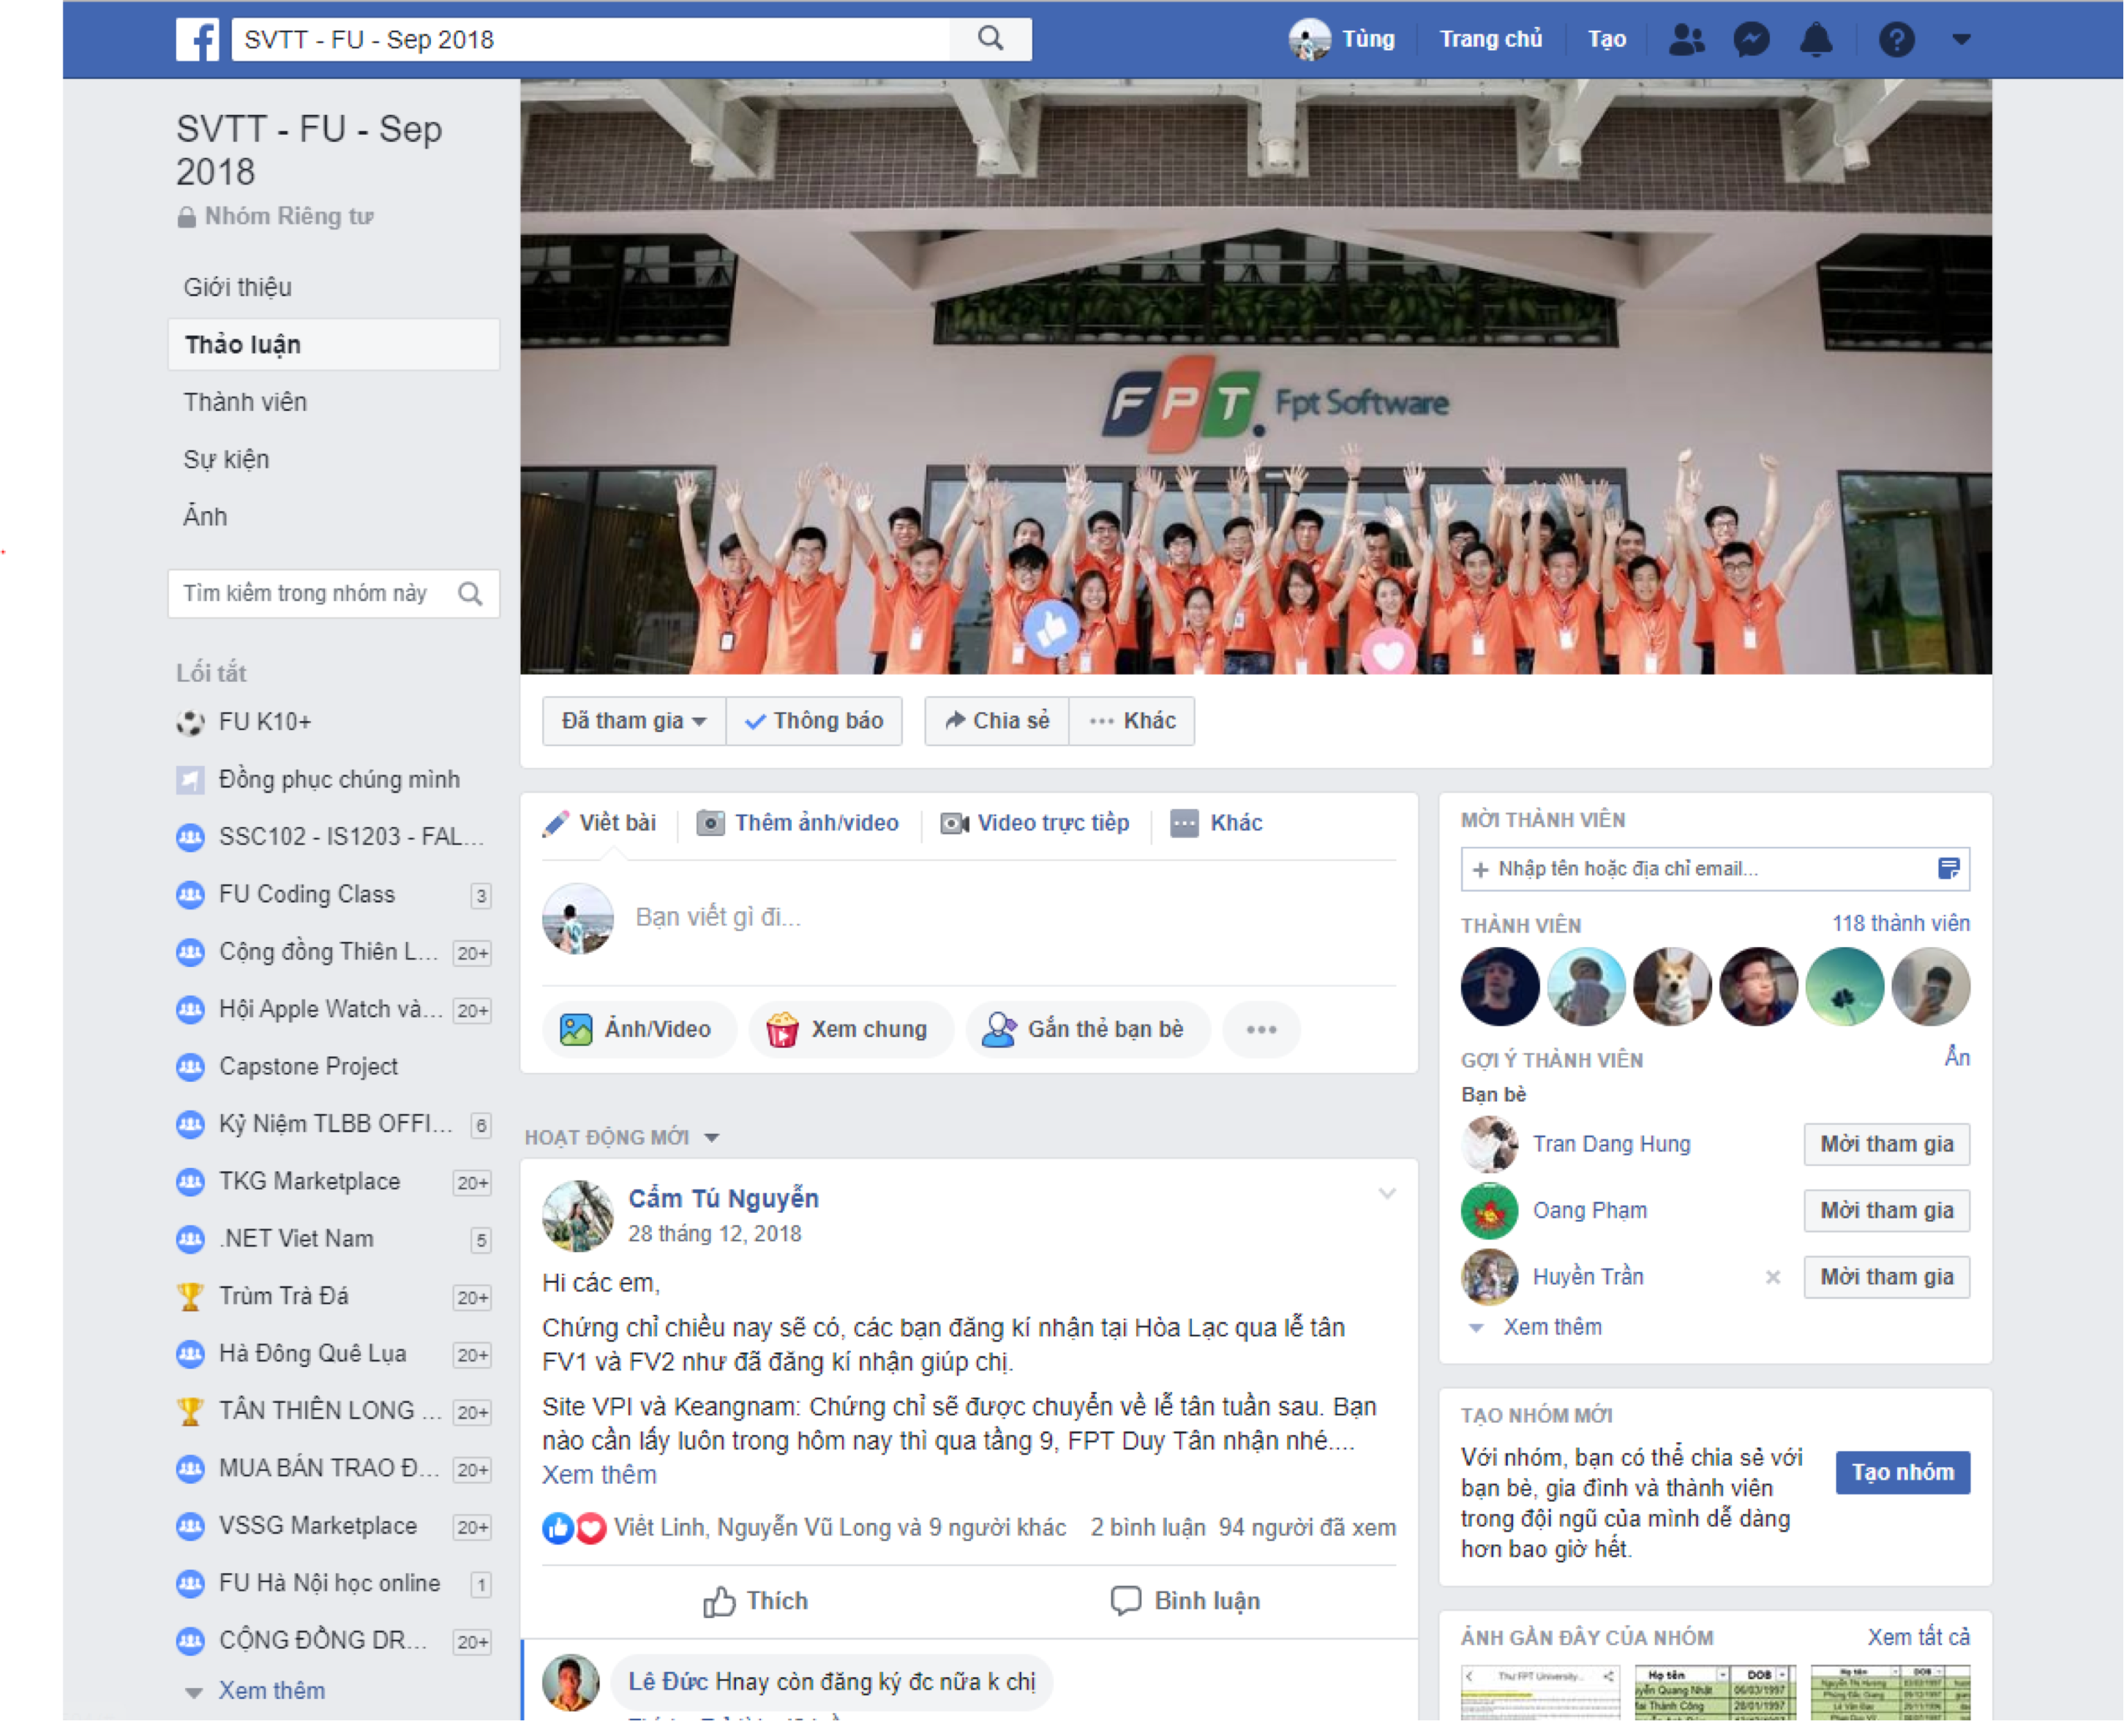
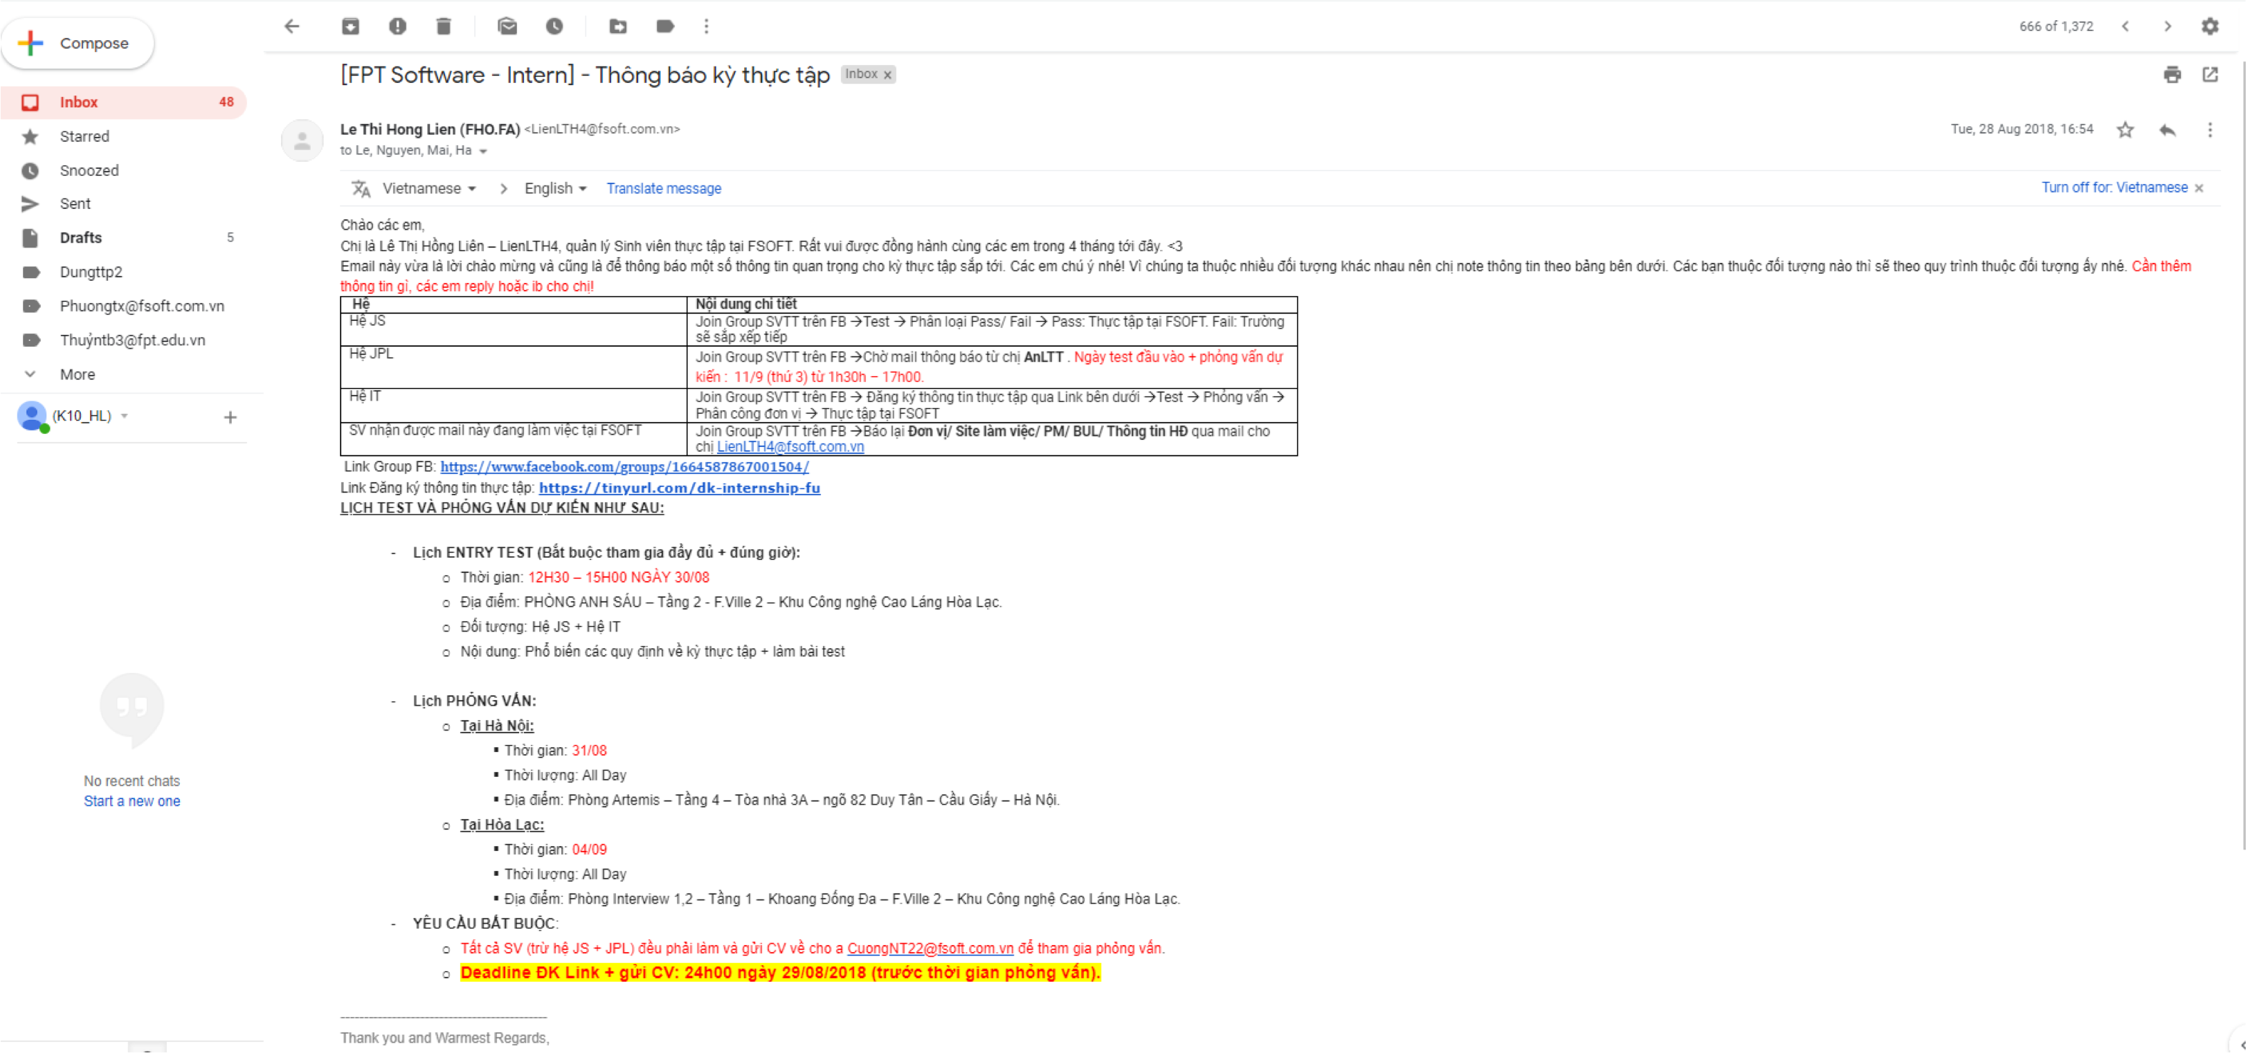
CURRENT SITUATION
5
SVTT – FU Group Facebook
Email

Slide 6
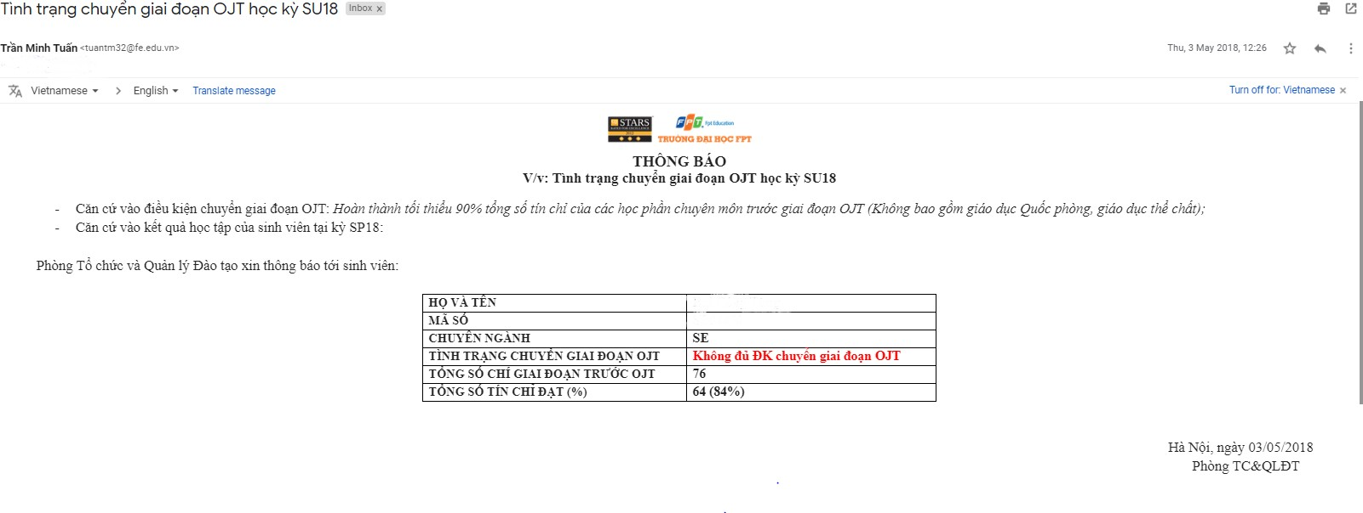
CURRENT SITUATION
6
Email

Slide 7
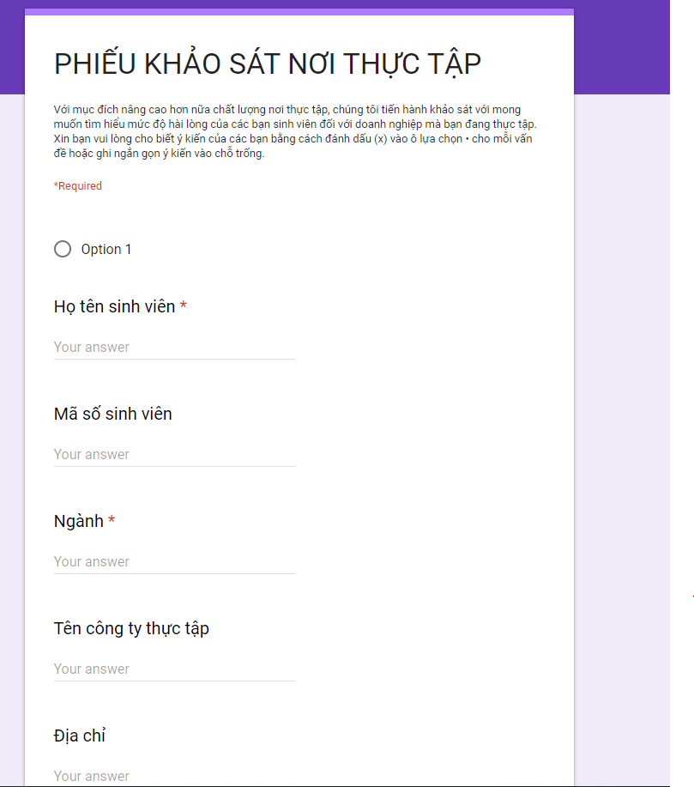
CURRENT SITUATION
7
REVIEW AFTER INTERNSHIP
=> Waste of time, money and manpower

Slide 8
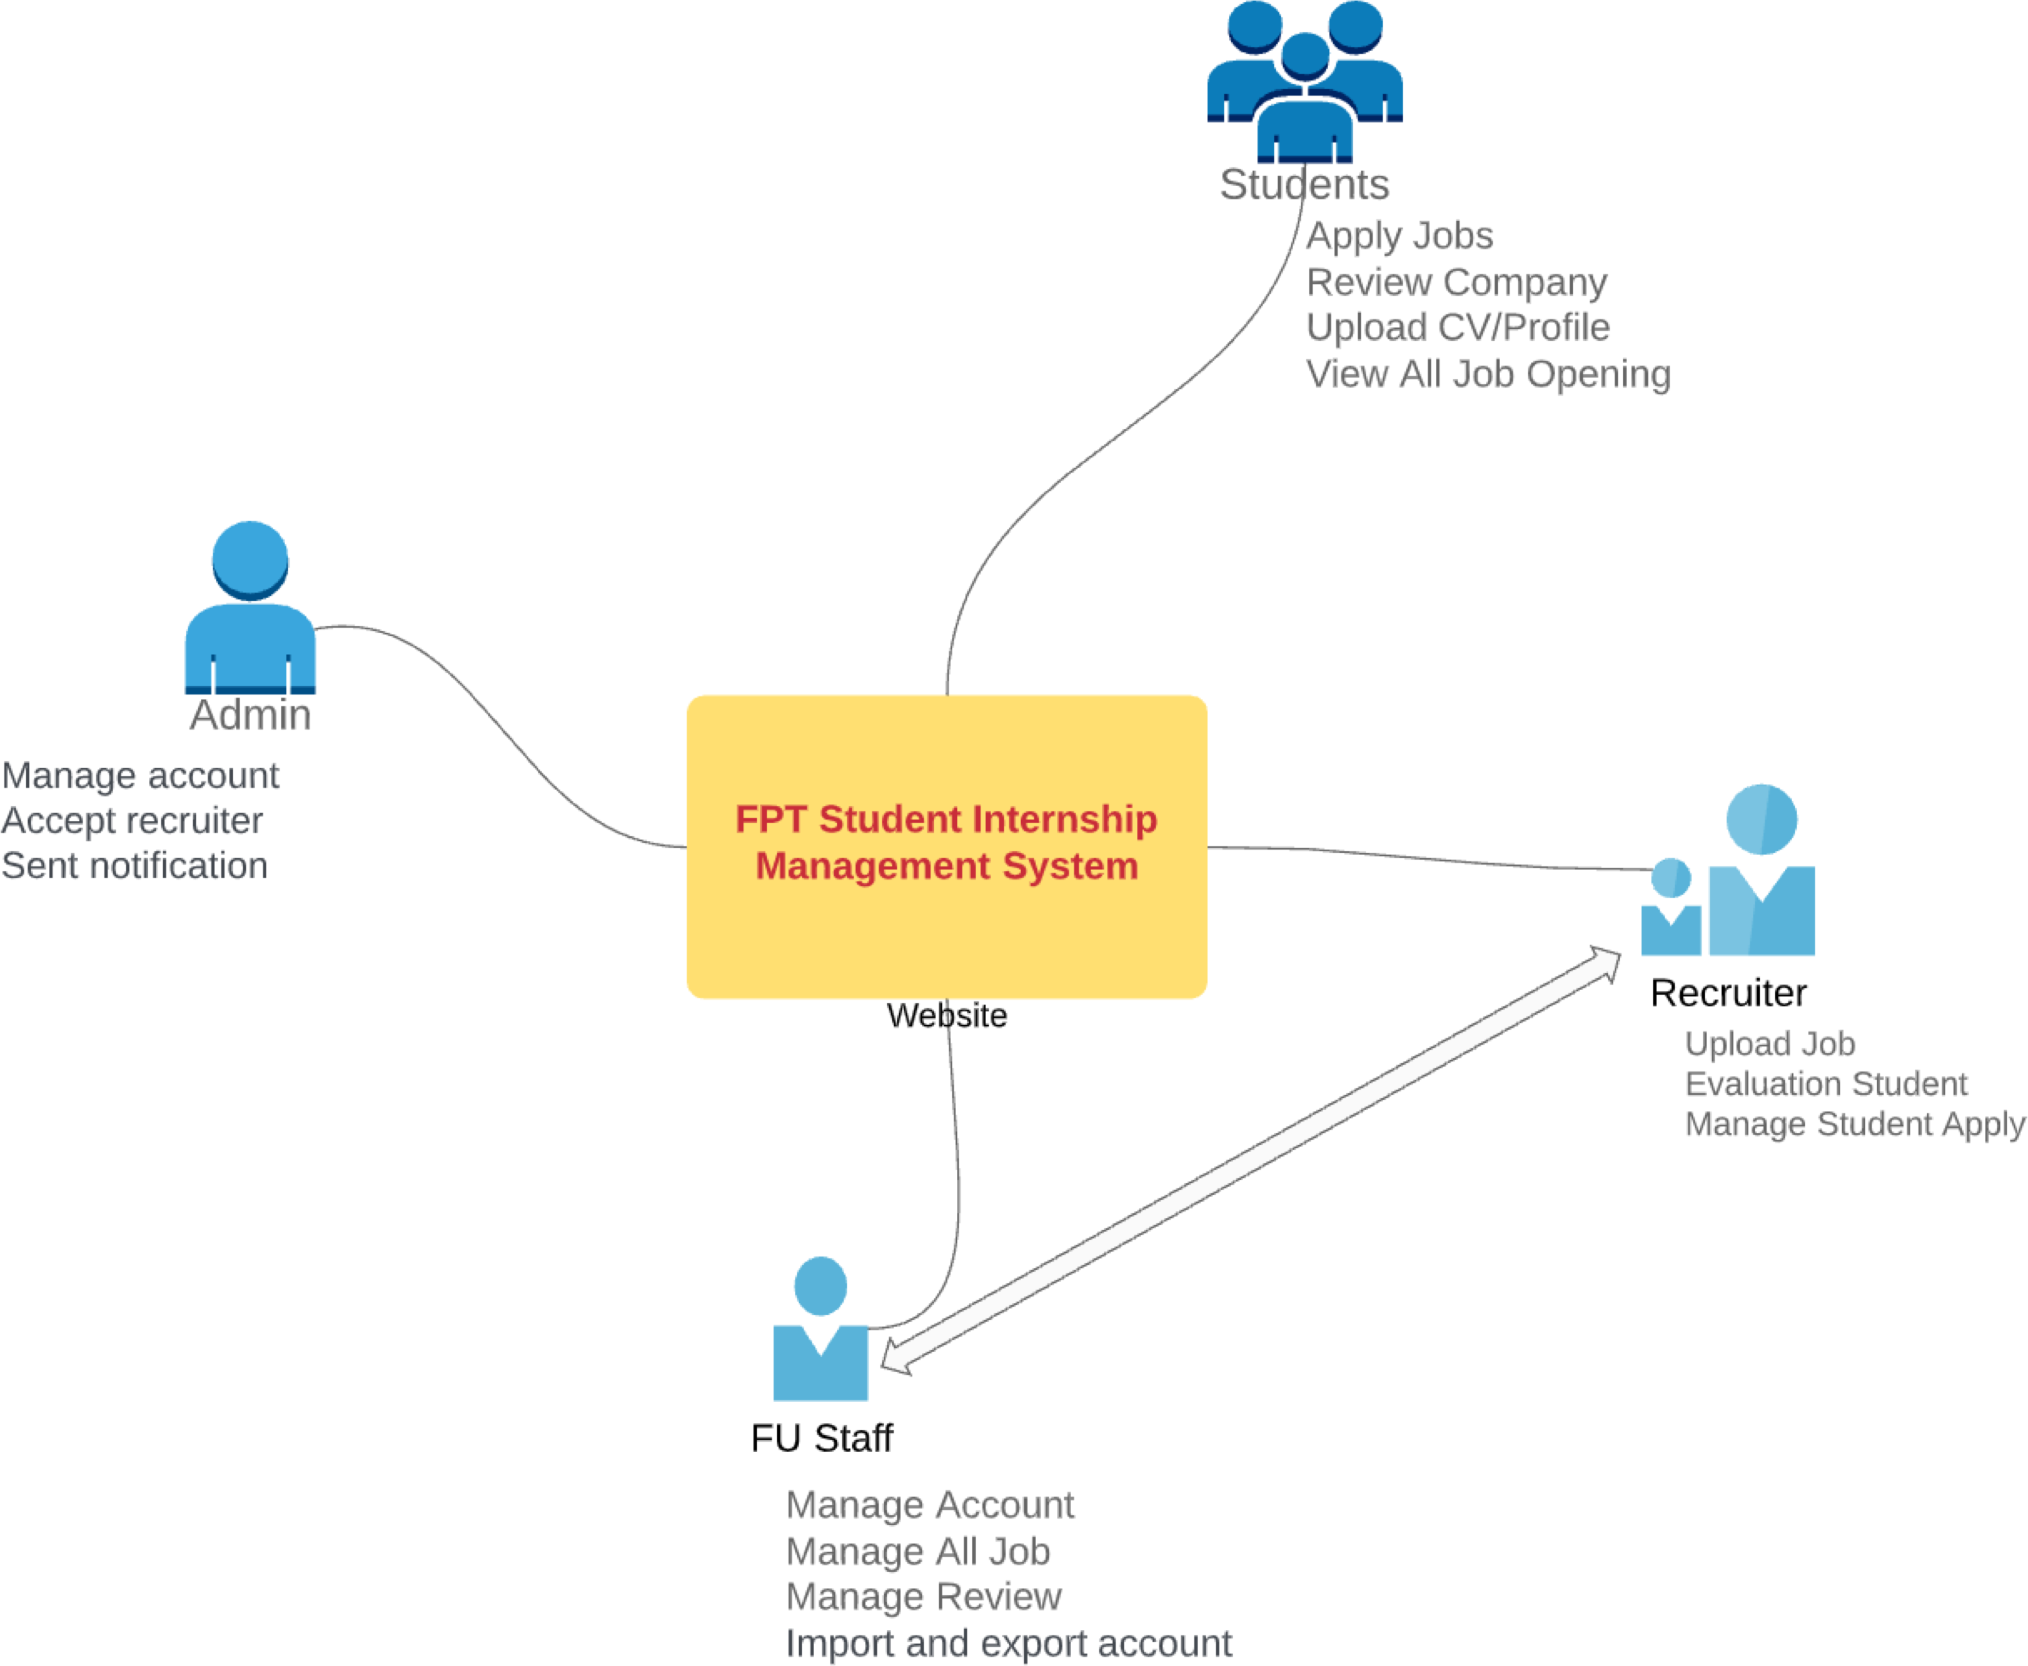
Solution
8
1. Proposal definition

Slide 9
Solution
9
System function
Check profile students in FPT University.
Evaluate the students after internship.
Search by criteria of students, recruiter.
Upload Job, Profile.
View information about your internship provided by the recruiter.
Evaluation, feedback, comments recruiter.
Recommend aspiration.
Detail information about one recruiter.
Accept recruiters into the system.
Table of quality statistics of students of 1 course internship.
Manage current student, recruiter status (add, edit, delete students).

Slide 10
Solution
10
3. Out of Scope
Dashboard page for administrators to view system statistics.
ChatBot, ChatBox.
Support for multi campuses.
Book interview schedule
Phone Application

Slide 11
02
11
Project Management

Slide 12
TEAMWORK
12
Time : 6h / day , 5days / week
Location : Room F305 , FPT University Hoa Lac
Communication : Phone , Email , Facebook , Trello
Supervisor meeting : Once a week Teambuildig : Once a month

Slide 13
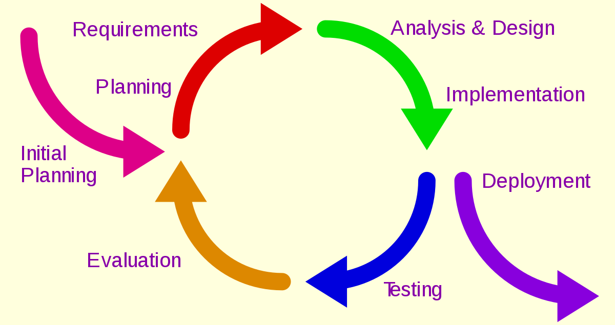
SOFTWARE PROCESS MODEL
13

Slide 14
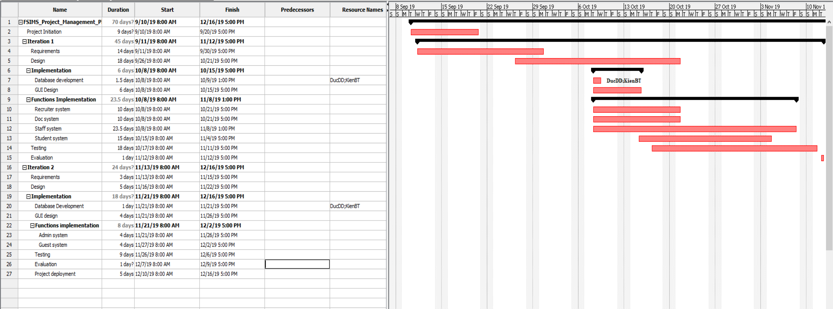
PROJECT MANAGEMENT PLAN
14

Slide 15
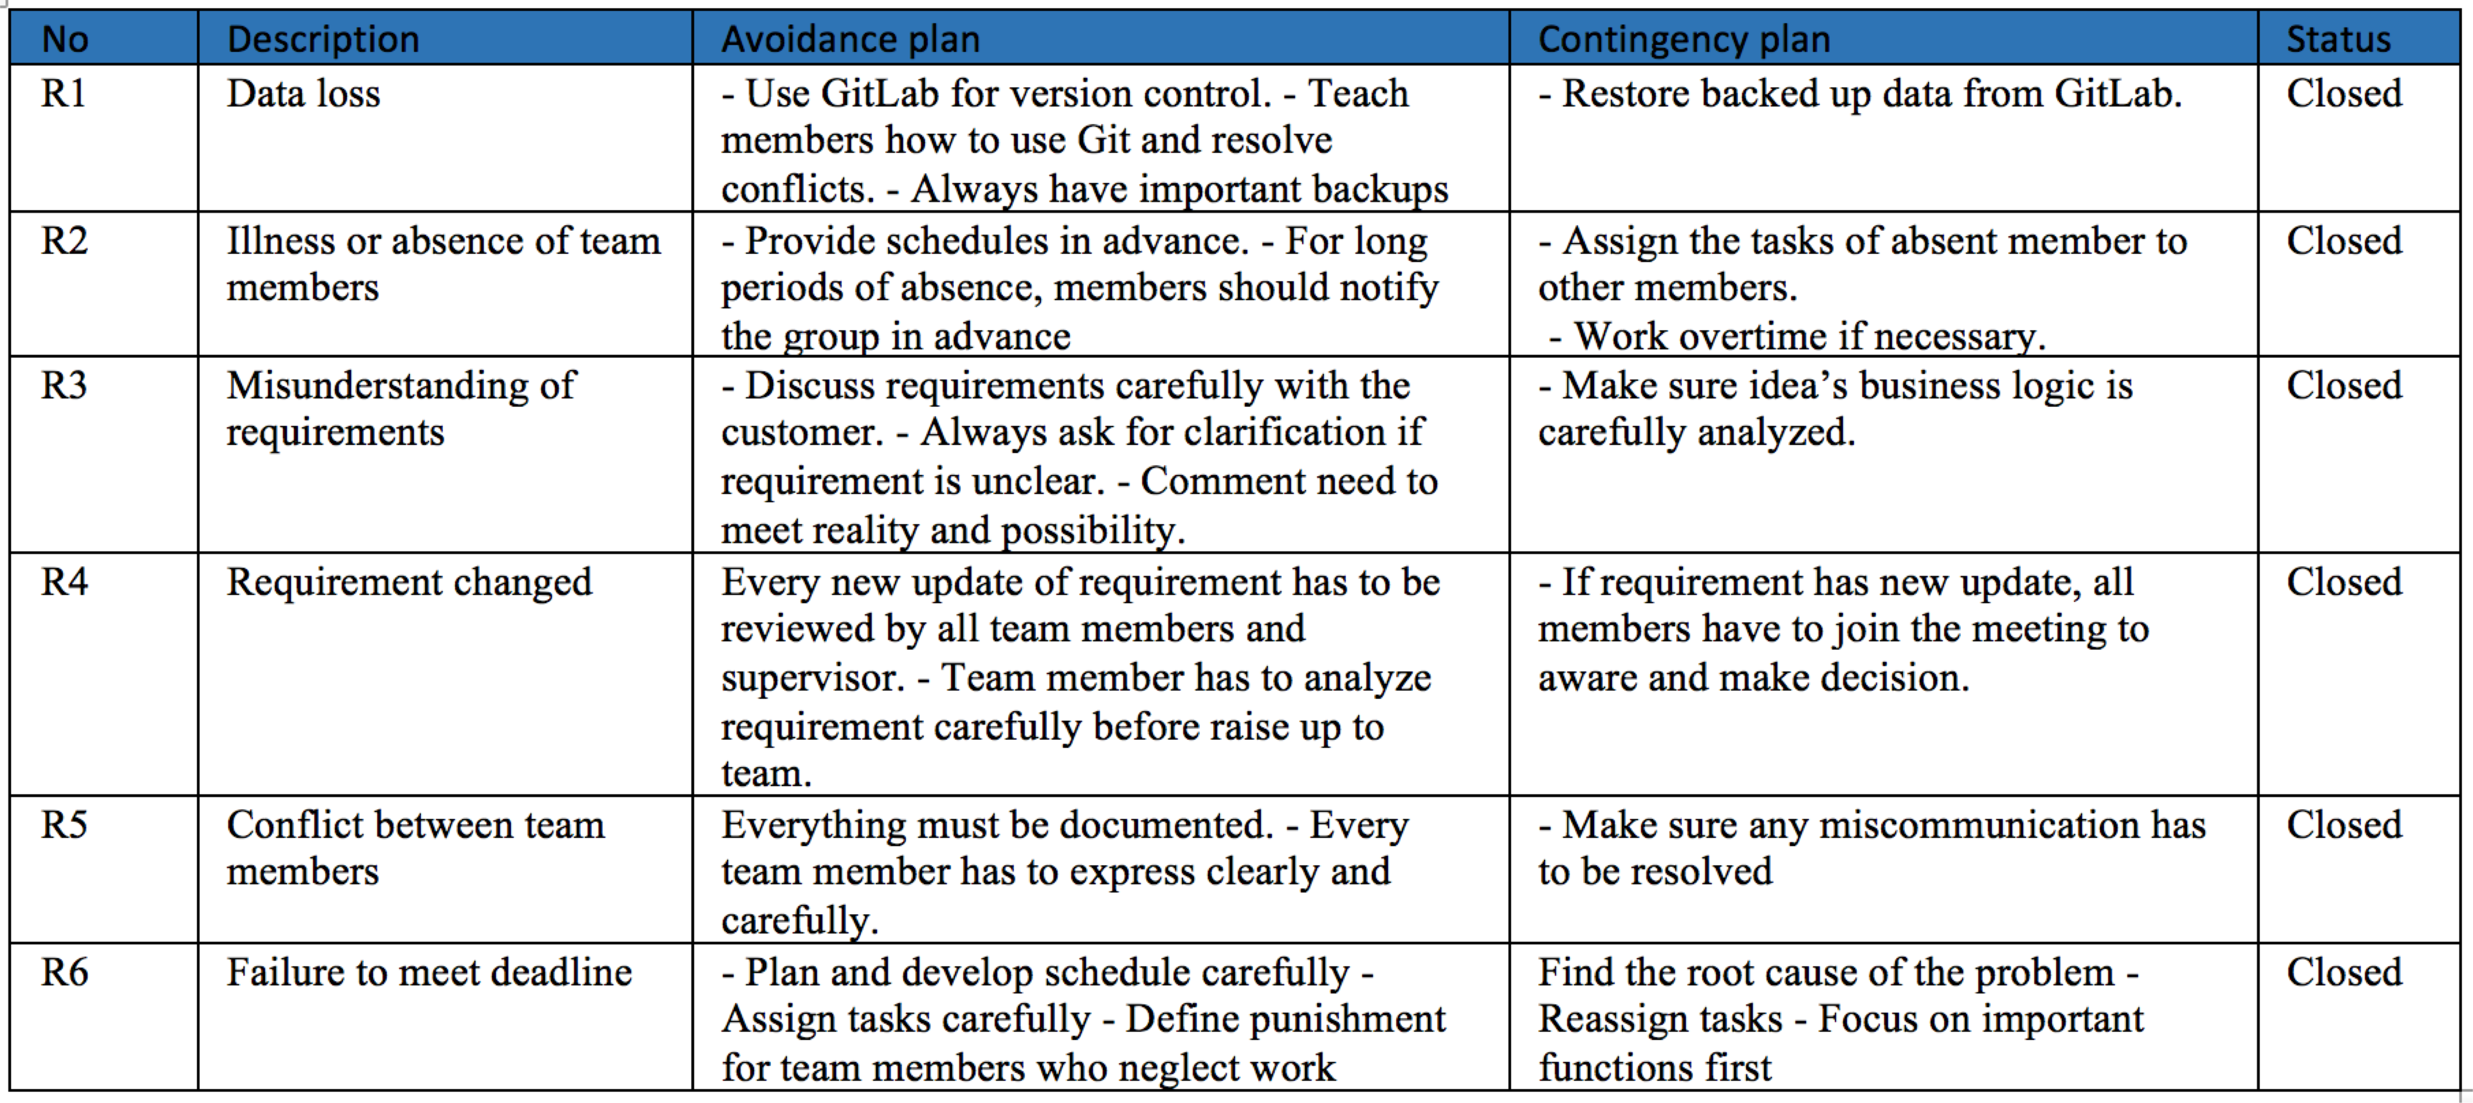
RISK MANAGEMENT
15

Slide 16

PROJECT TOOLS
16
ASP .NET C# 2017
FACEBOOK
SQL SERVER 2017
SKYPE , TRELLO
PROJECT LIBRE , EXCEL
GITHUB

Slide 17
03
17
Software Requirement Specification

Slide 18
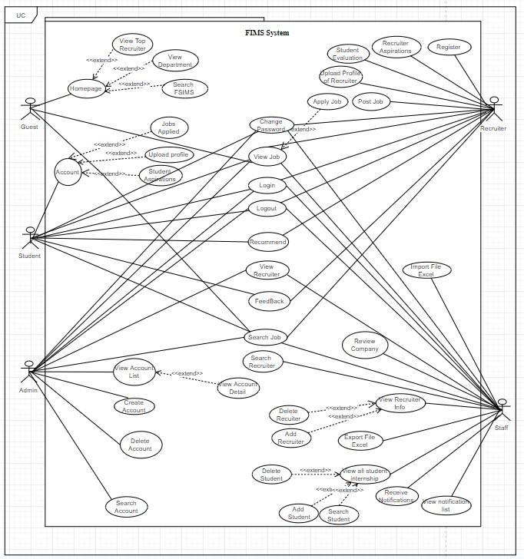
USECASE DIAGRAM
18
5 ACTOR
Guest : 6
Admin : 15
Staff : 24
Student : 15
Recruiter : 14

Slide 19
USER REQUIREMENT
19
MAIN FUNCTION:
Guest System
Student System
Staff System
Admin System
Recruiter System

Slide 20
SYSTEM REQUIREMENT
20
User interface
Hardware interface
Software interface

Slide 21
NON-FUNCTIONAL REQUIREMENT
21
Security
Performance
Usability
Maintainability & Scalability

Slide 22
04
22
Architecture Design

Slide 23
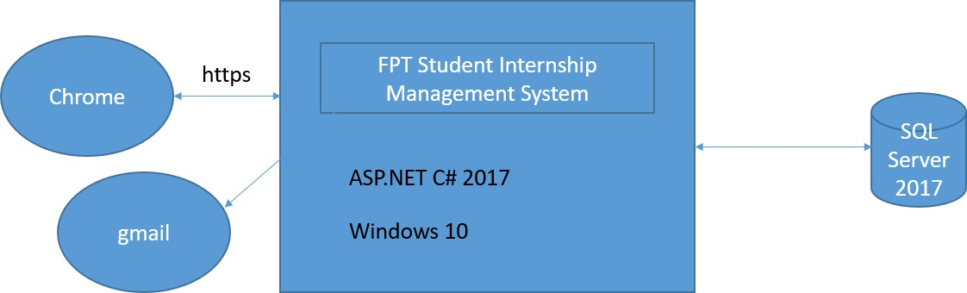
SYSTEM OVERVIEW
23

Slide 24
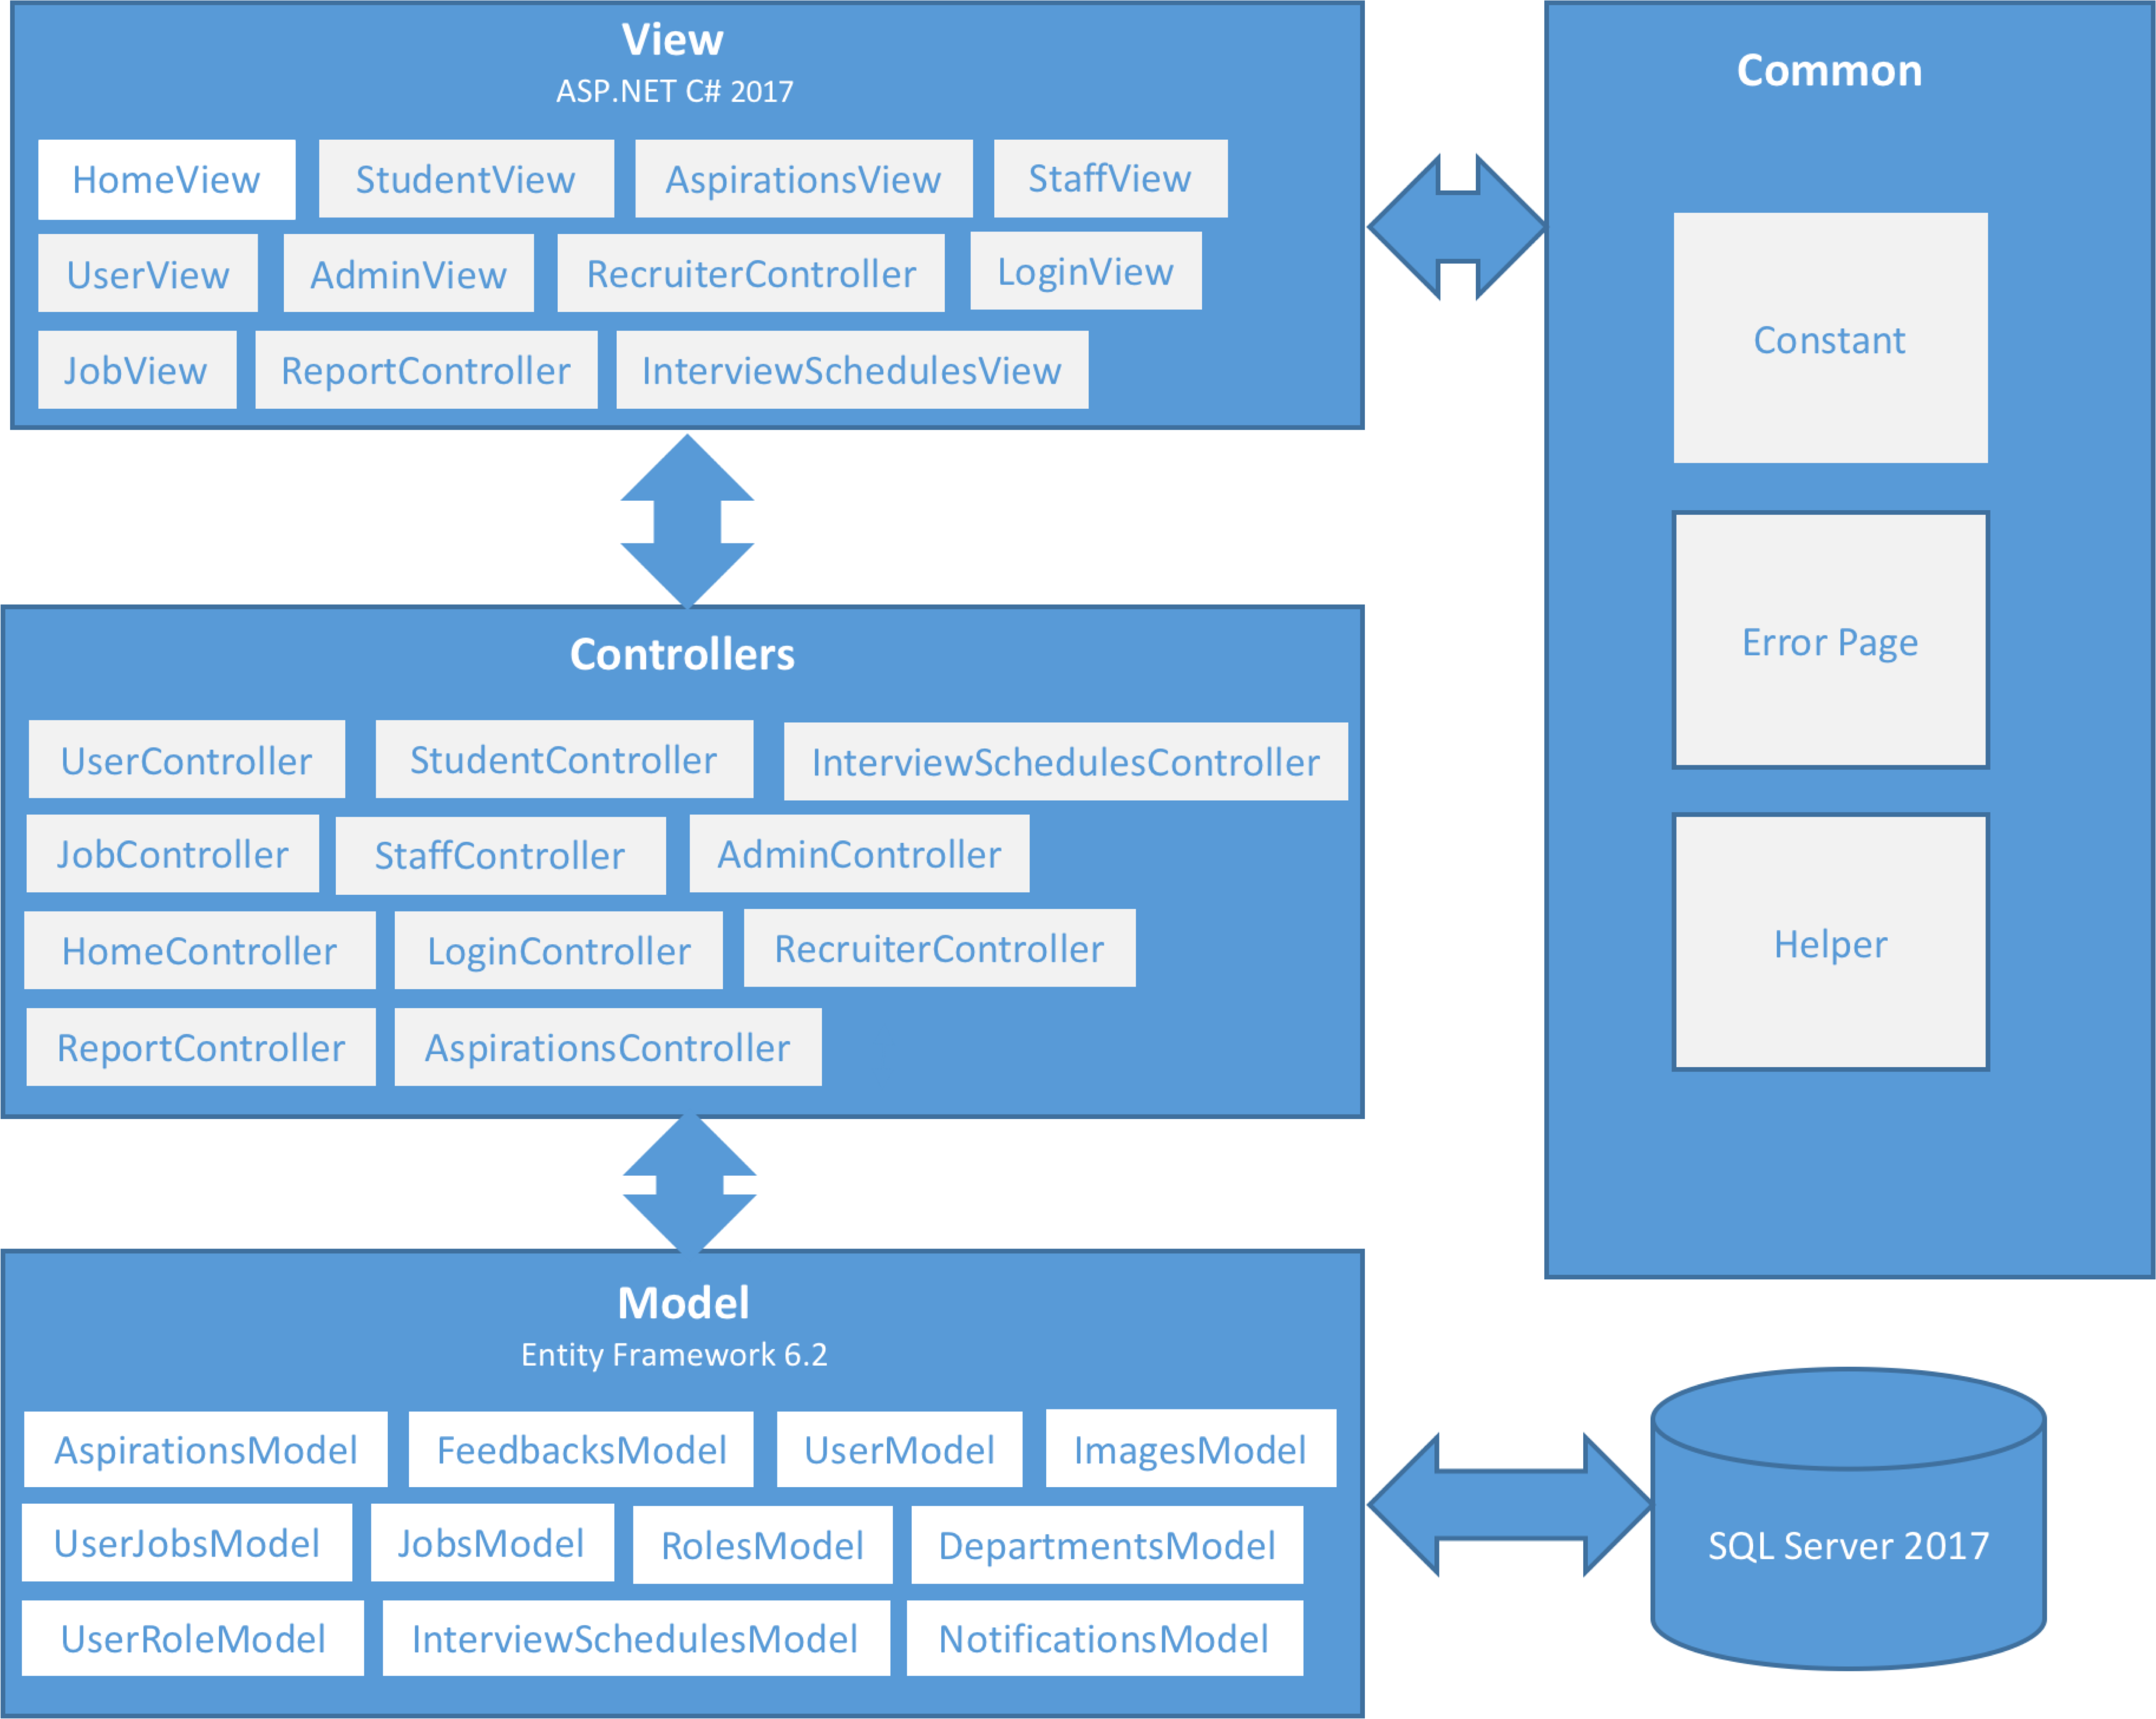
ARCHITECTURAL LAYERS DESIGN
24

Slide 25
05
25
Database table diagram

Slide 26

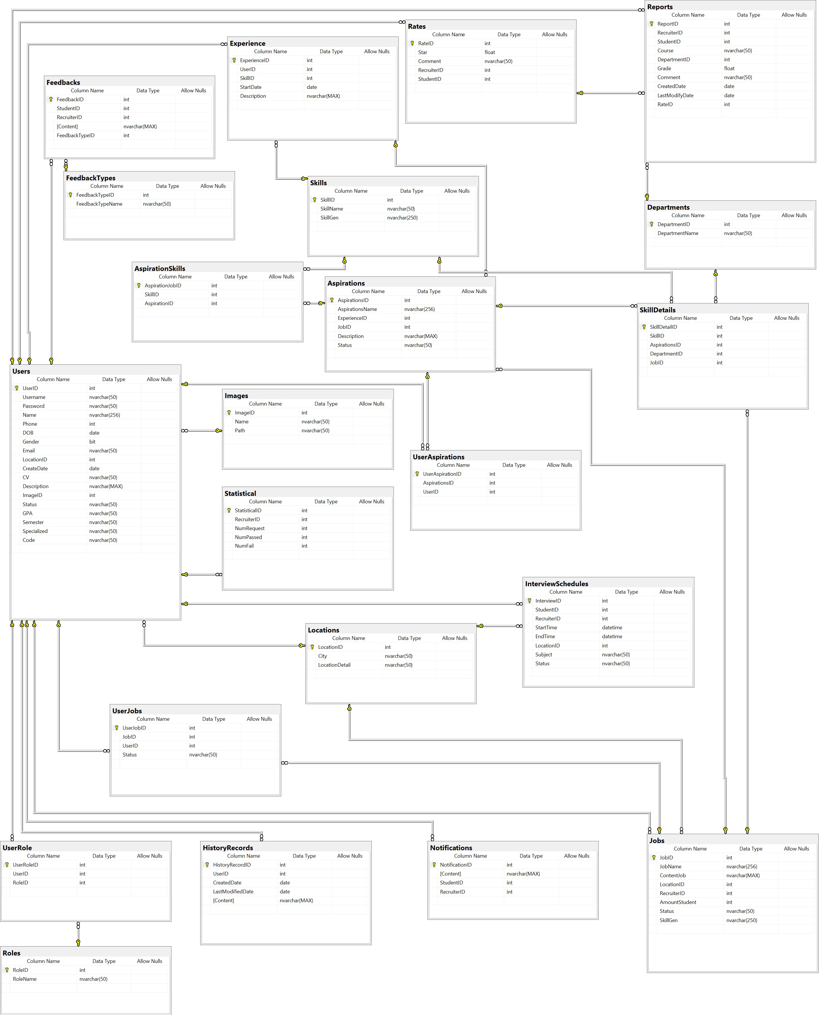
DATABASE DIAGRAM

Slide 27
27
06
Detail Design

Slide 28
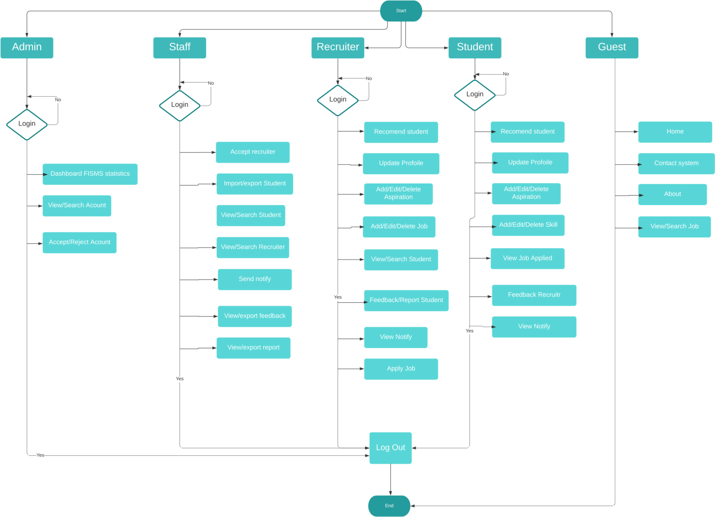
28

Slide 29
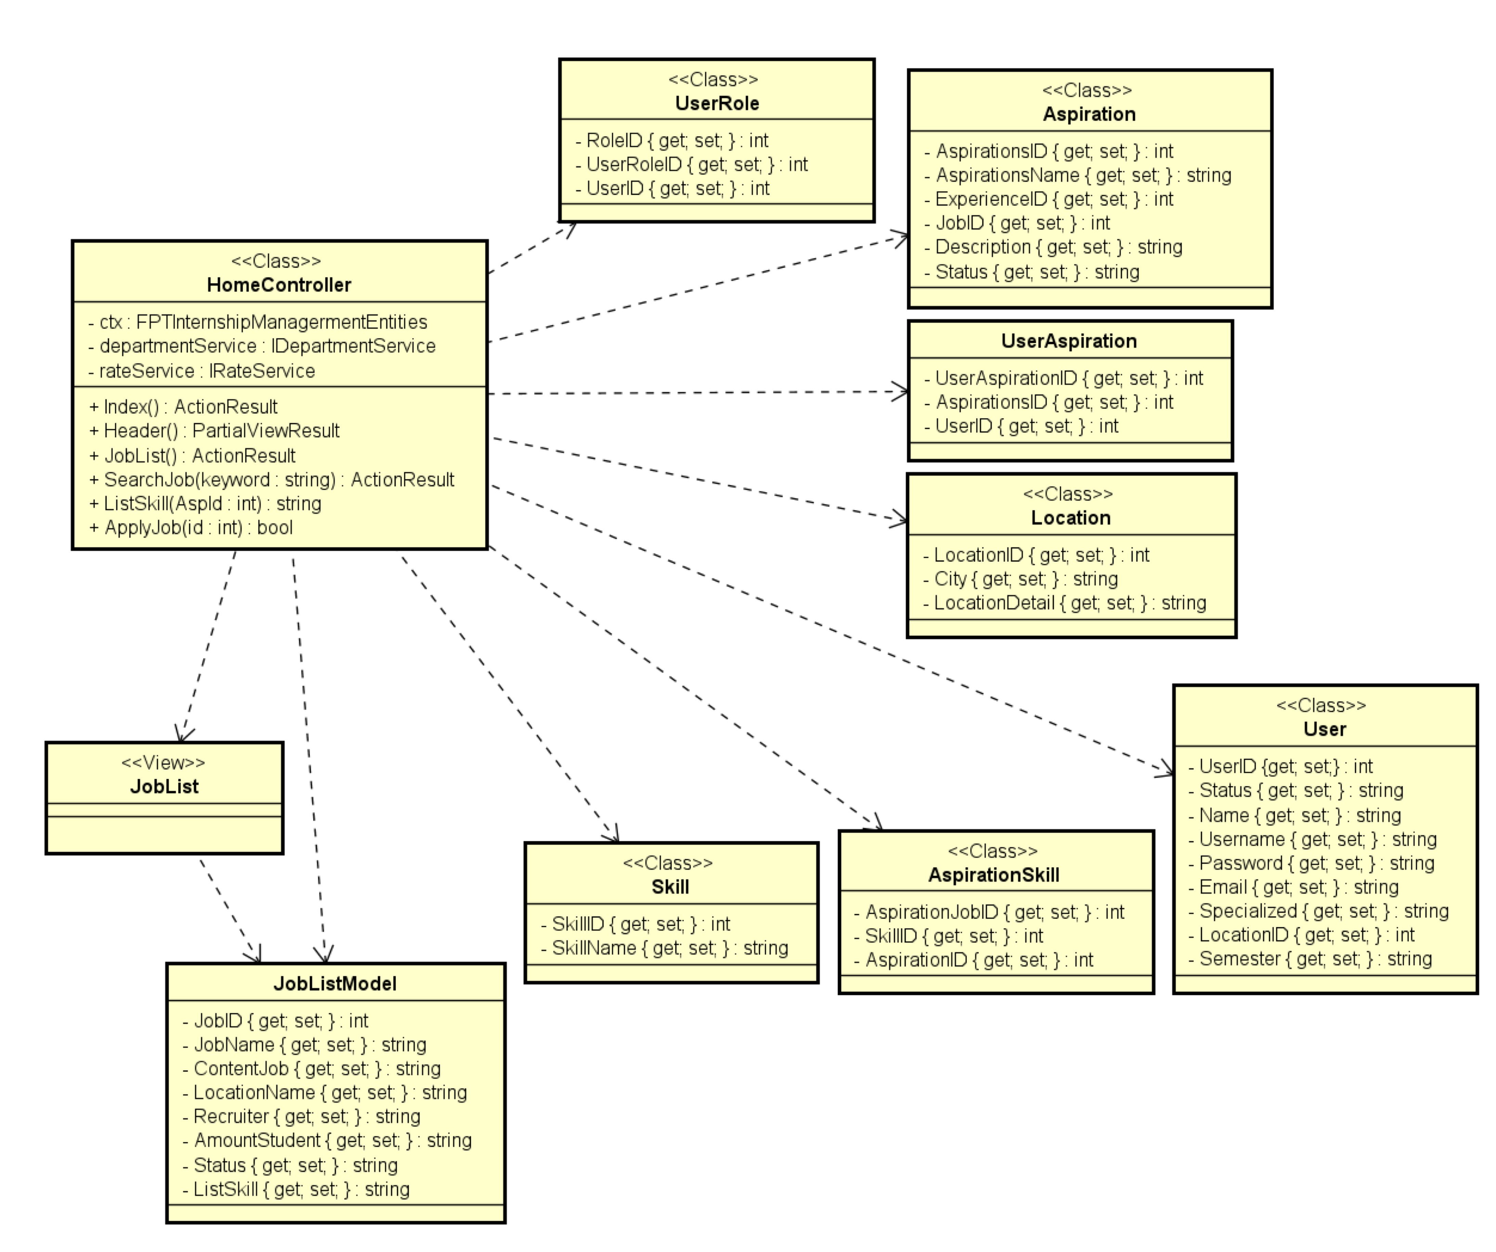
CLASS DIAGRAM
29

Slide 30
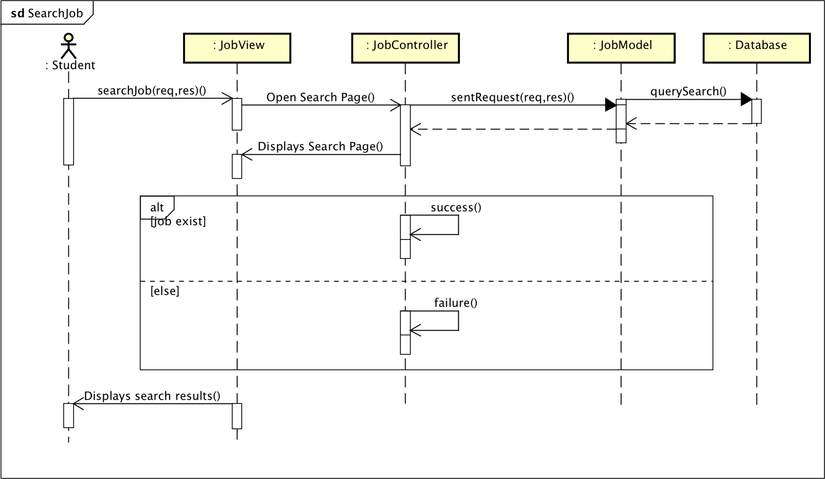
SEQUENCE DIAGRAM
30

Slide 31
07
31
TEST PLAN ENVIRONMENT TEST

Slide 32
INTRODUCTION
32
Test strategy
Test plan
Test approach
Defect log
Test report

Slide 33




TESTING TOOLS
33
View the WebPage Bug logging Page
View WebPage Bug Logging Page
Manage Test Case Report Bug
Mange Bug Communicate

Slide 34
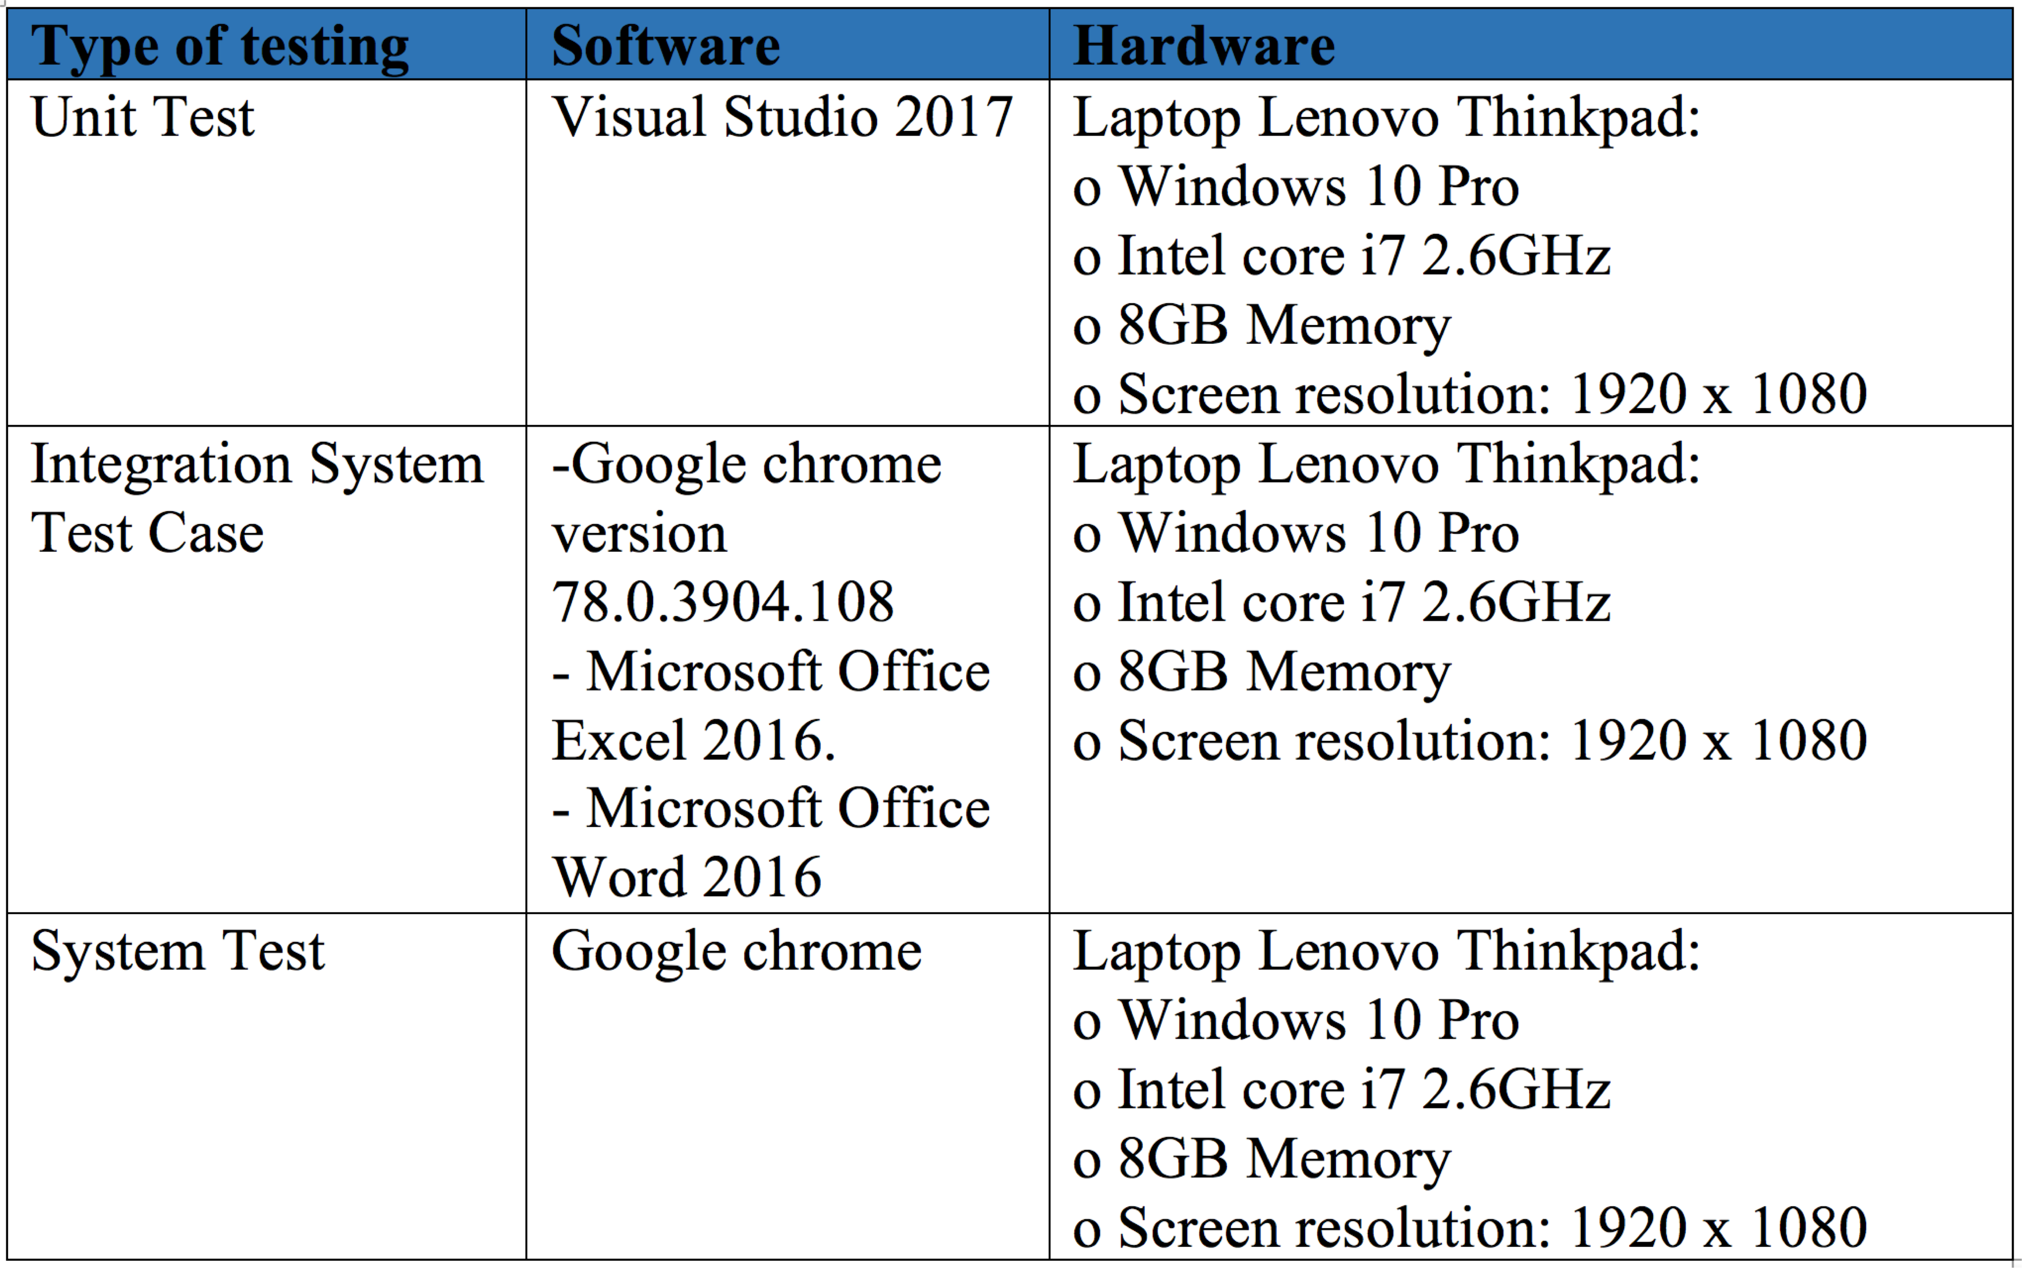
TESTING ENVIRONMENT
34

Slide 35
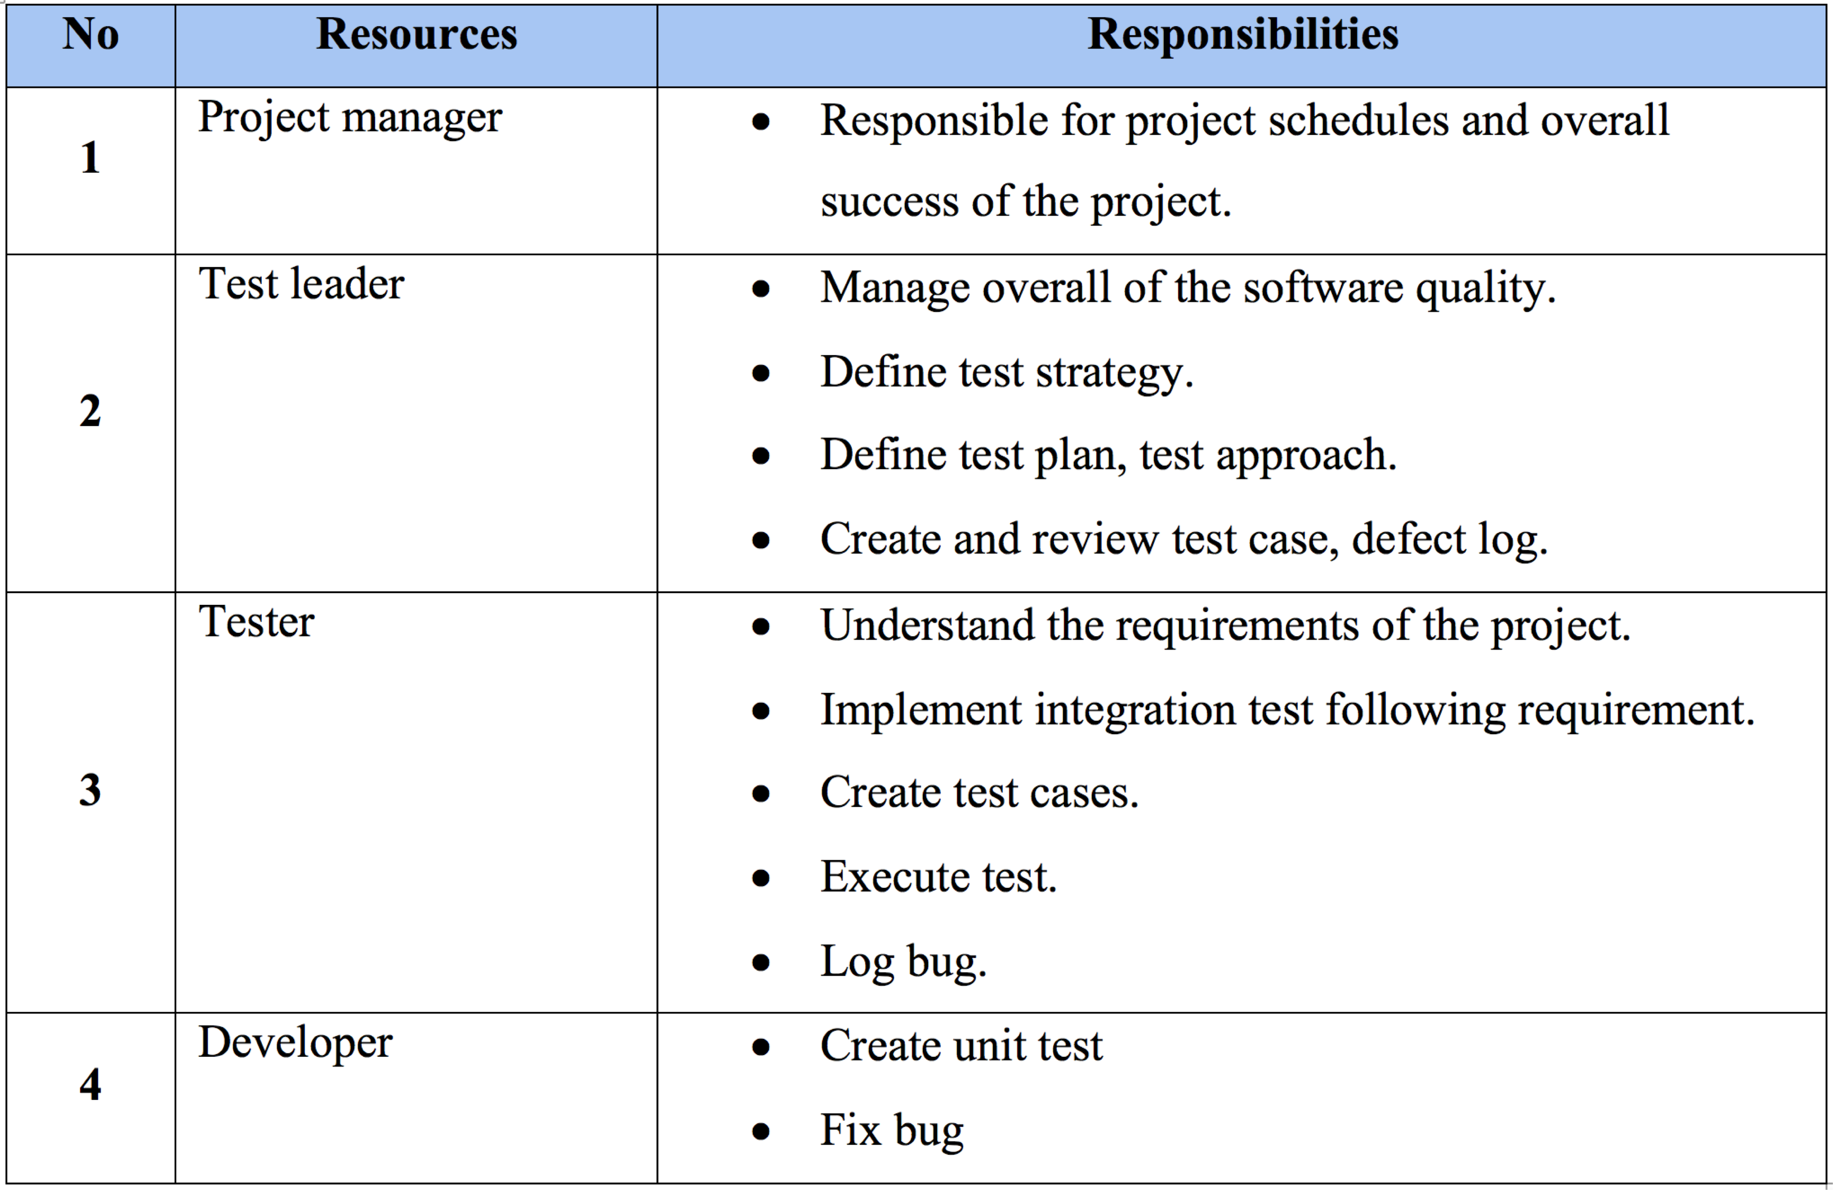
RESOURCES & RESPONSIBILITIES
35

Slide 36
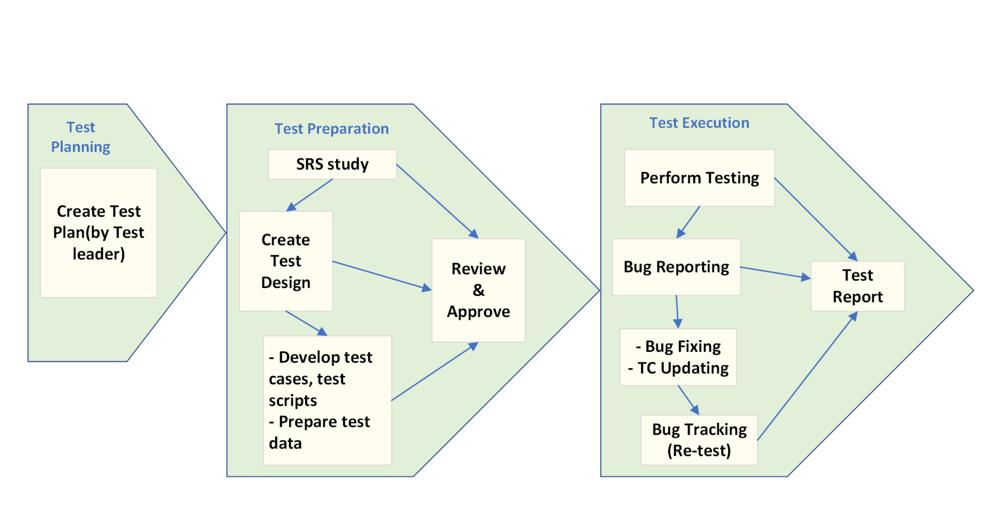
TEST PROCESS
36

Slide 37
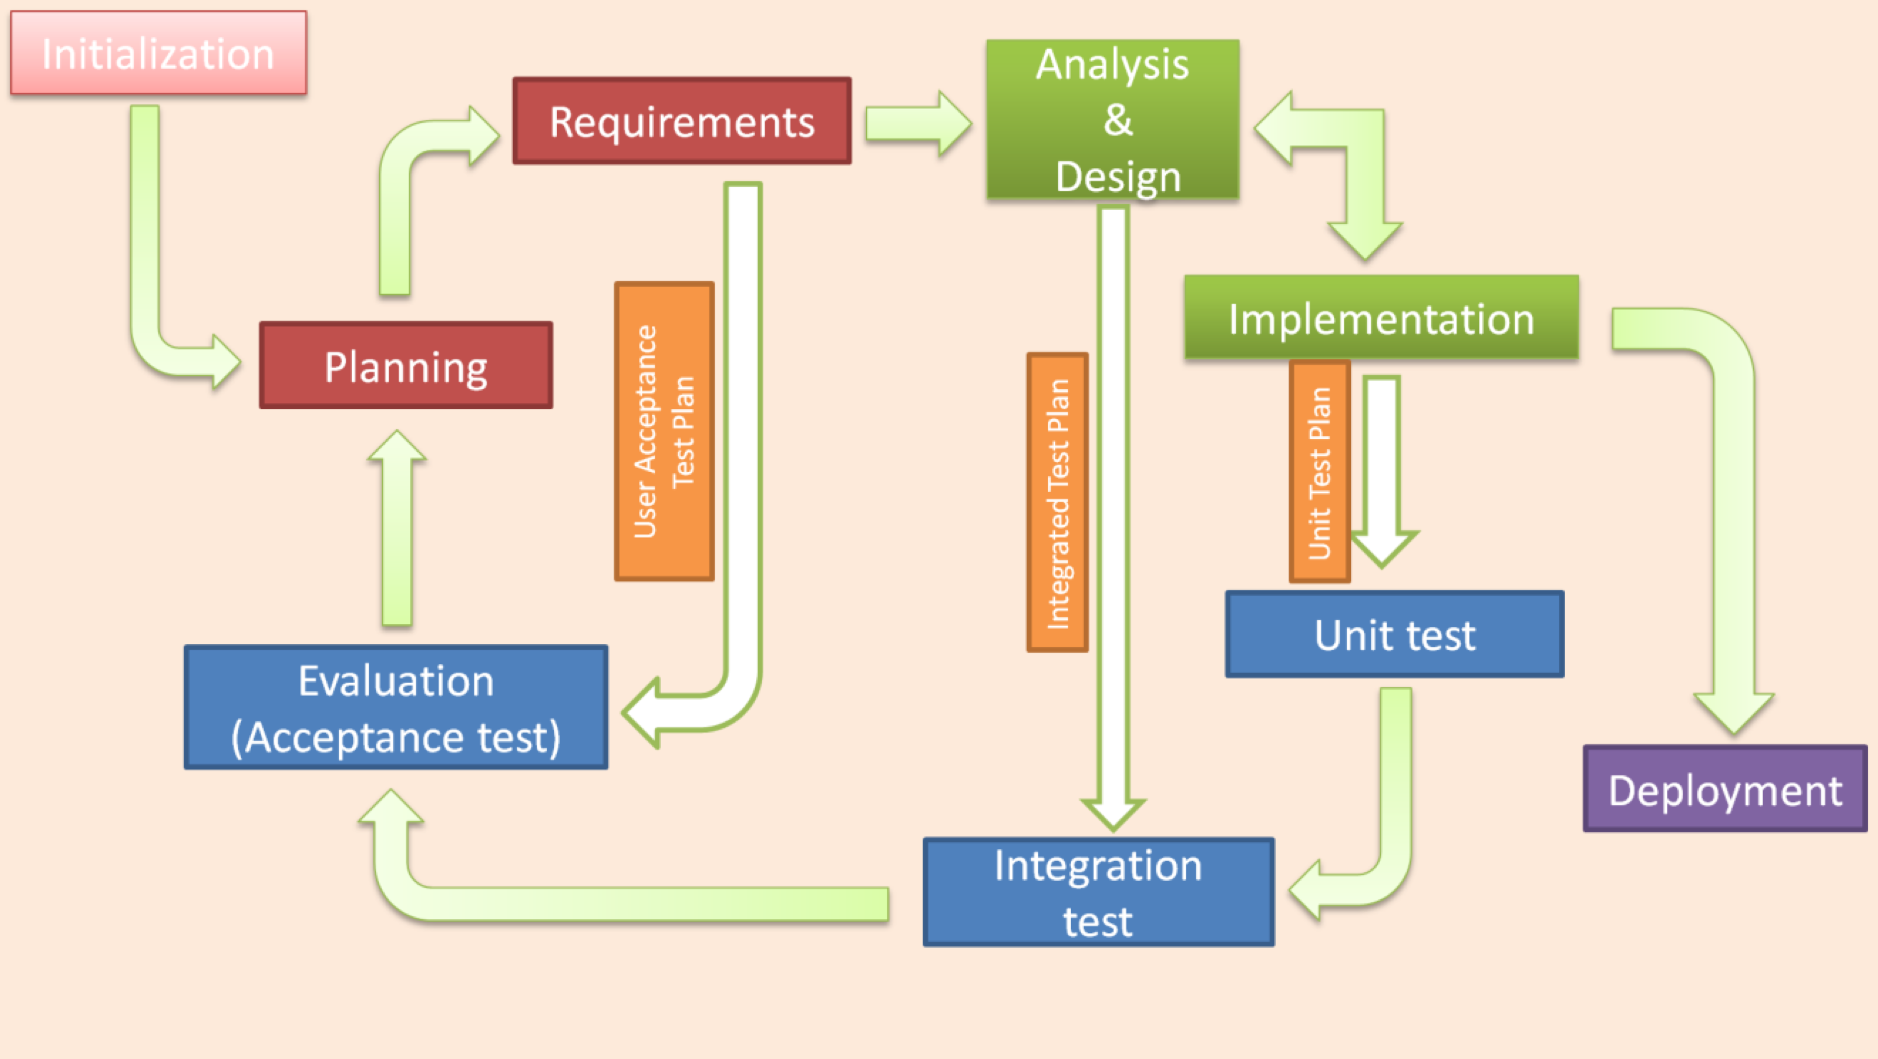
TEST MODEL
37

Slide 38
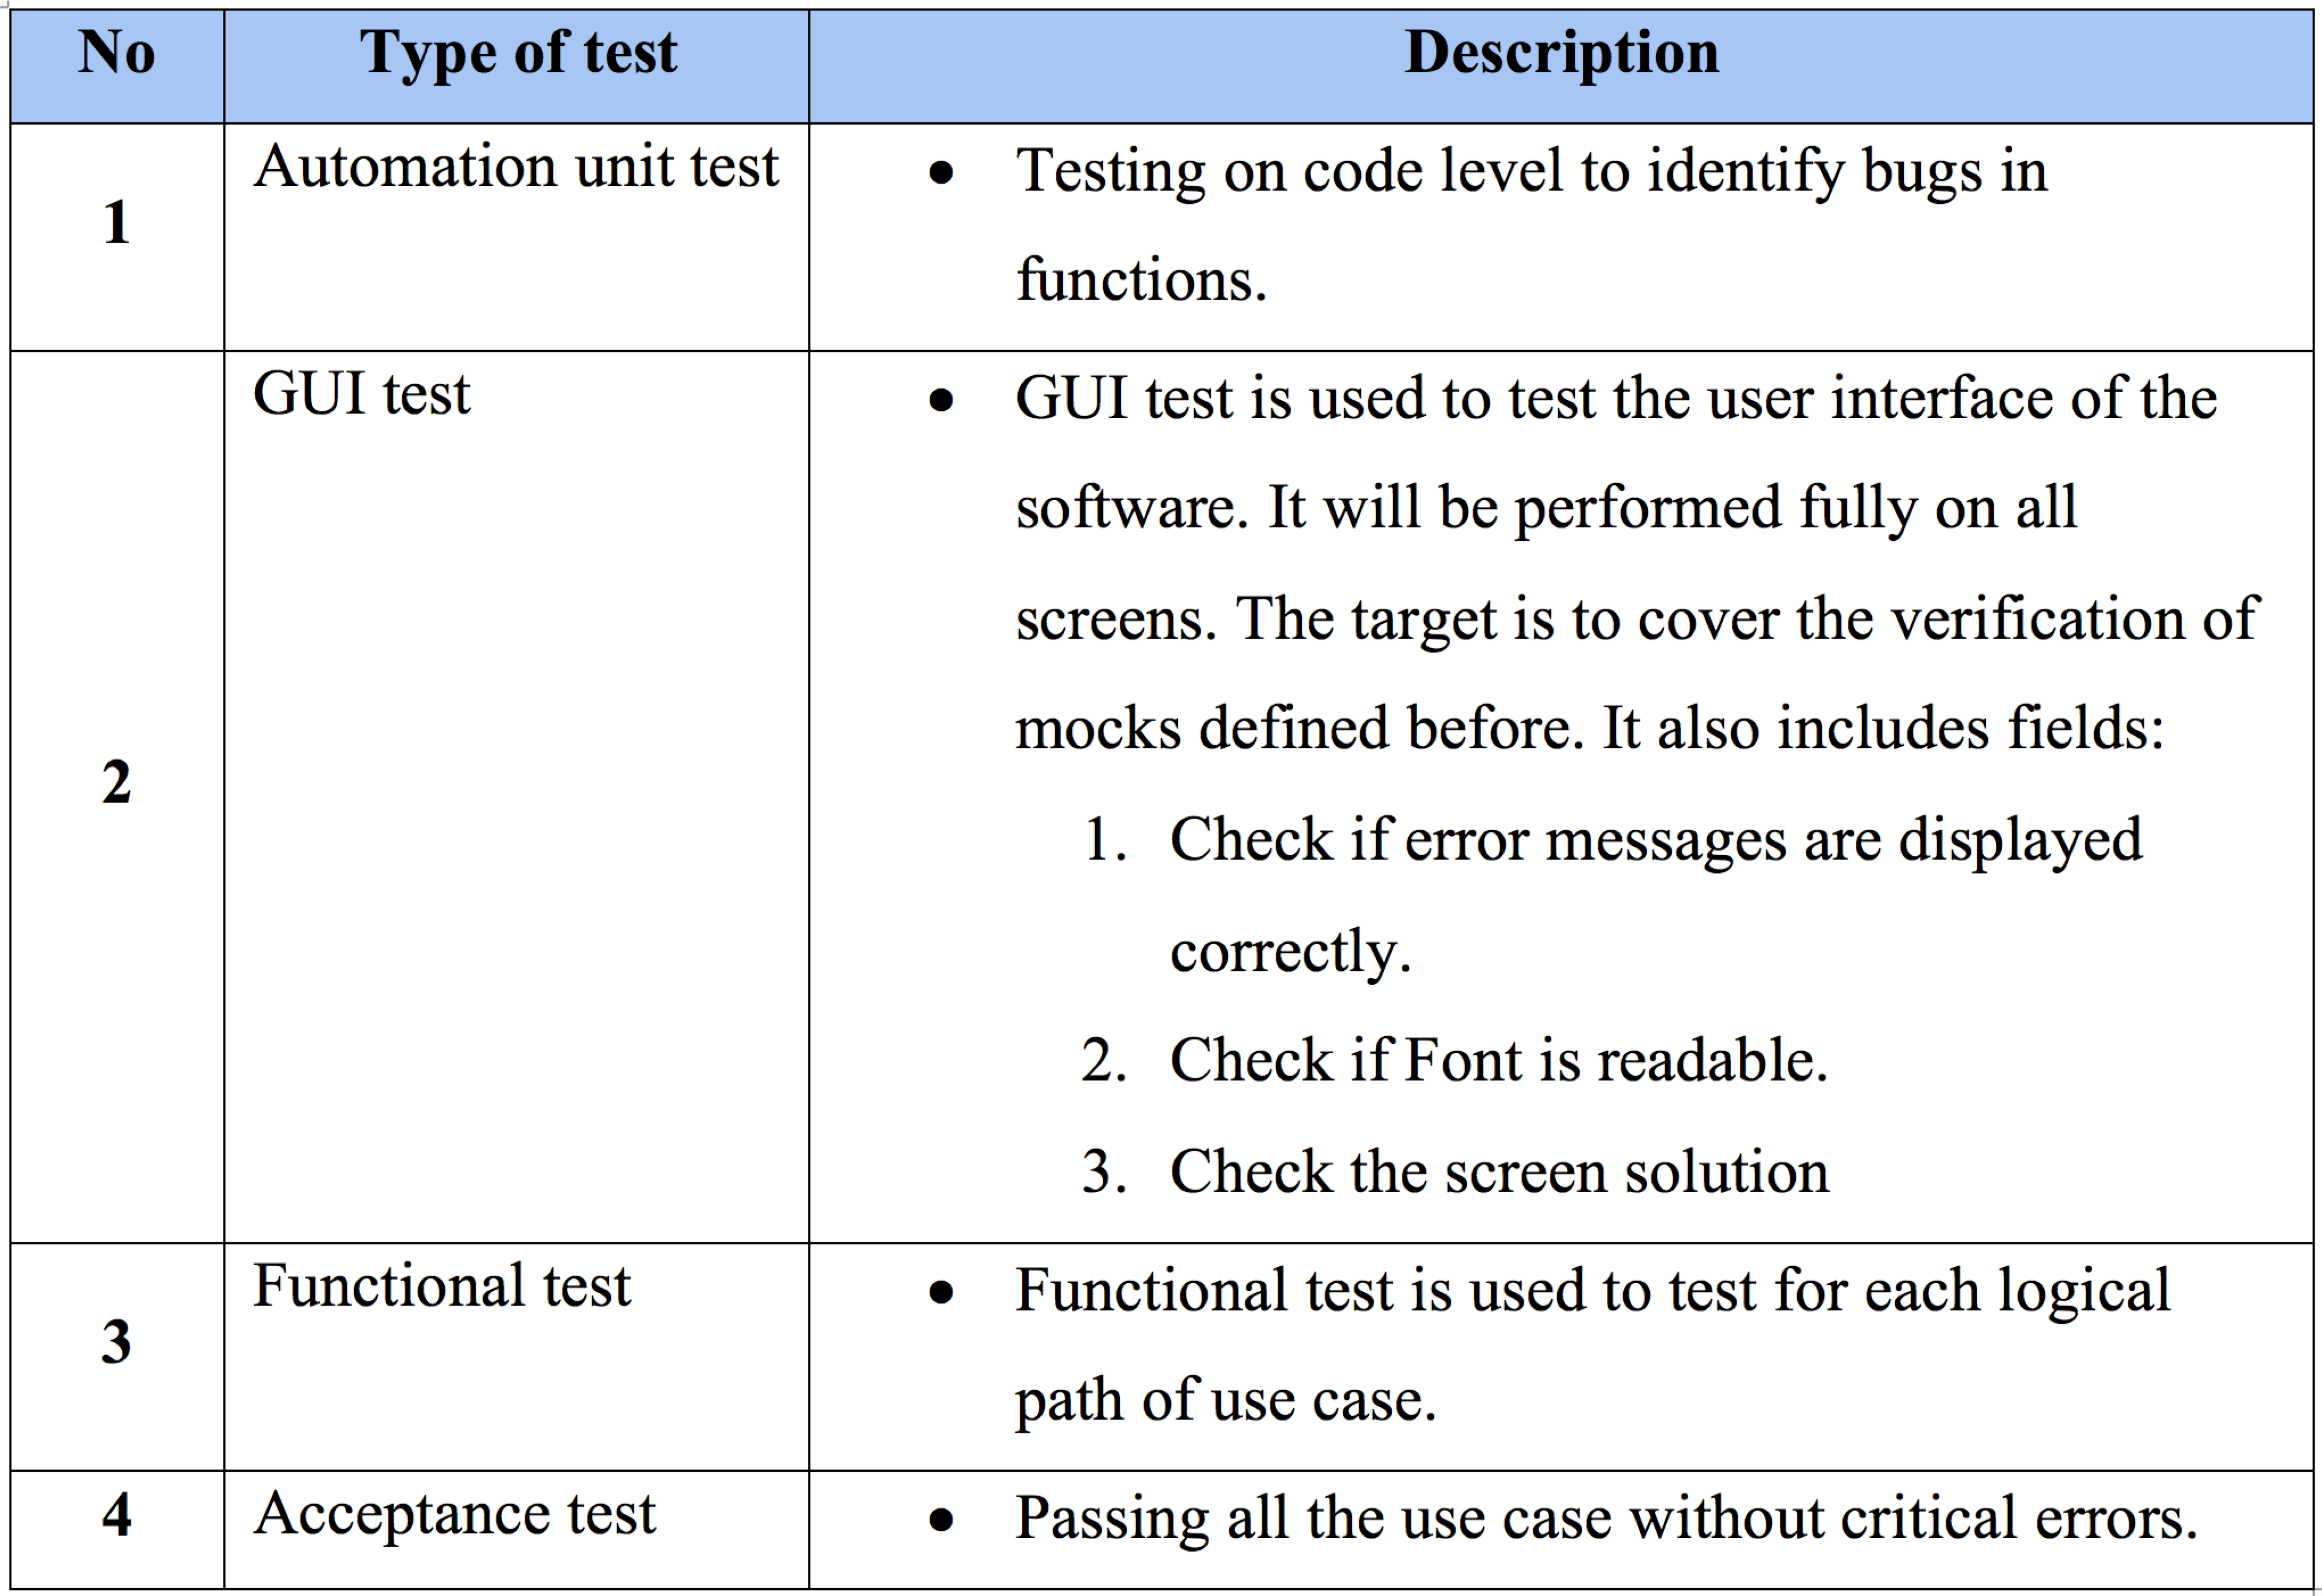
TYPE OF TESTING
38

Slide 39
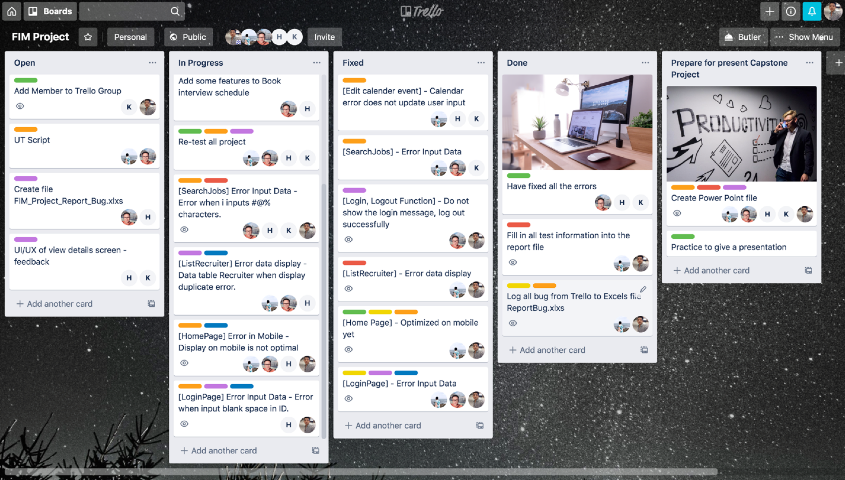
DEFECT LOG
39

Slide 40
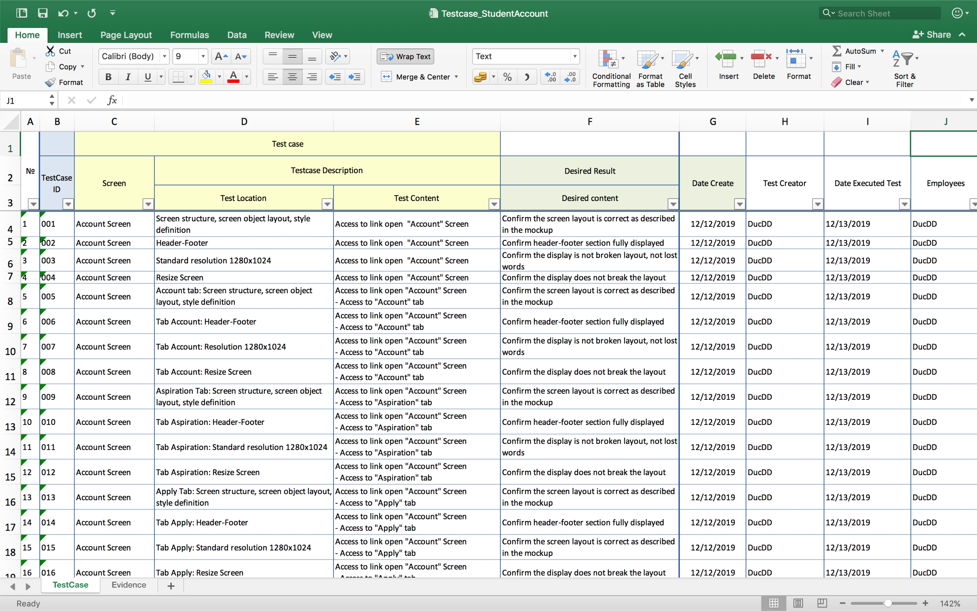
TEST REPORT
40

Slide 41
41
08
DEMO , Q&A

Slide 42
THANKS FOR WATCHING
42

